Slide 1
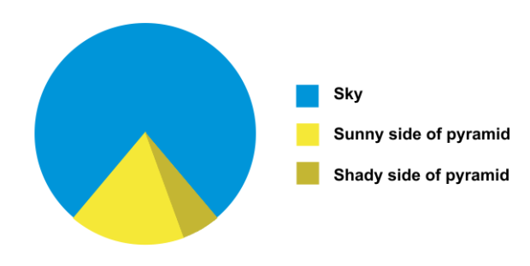

How Humans See Data: Best Practices for Data Viz
Marieke Jones, PhD
2020

Slide 2
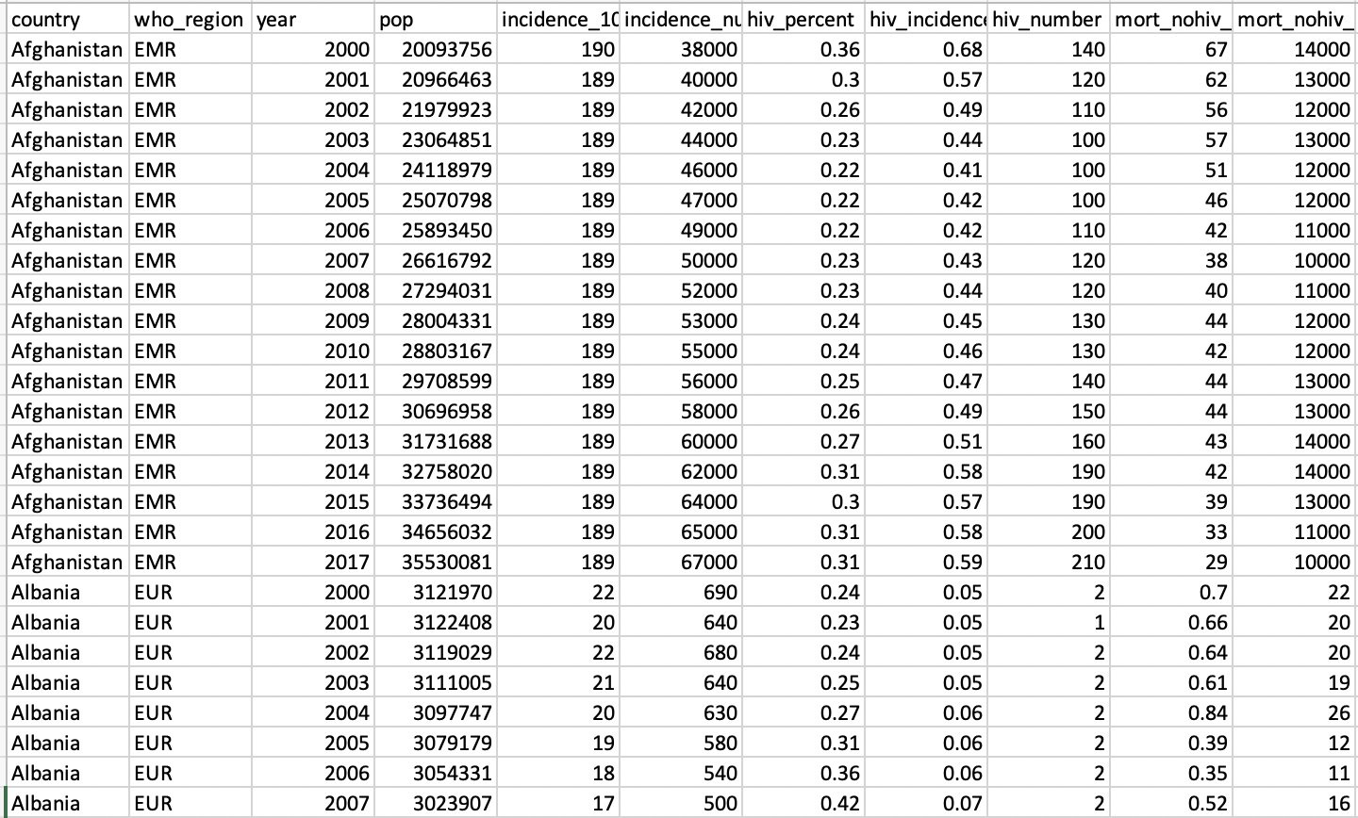
Raw data → Picture for communication
Notes:
Why do we even need viz? BC looking at raw data does not help us decipher meaning.
Purpose of a viz: Communication: Make new ideas pop into the heads of audience

Slide 3
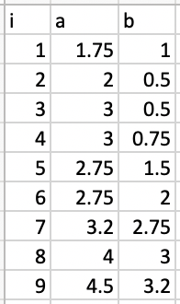
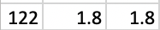
.
.
.
Notes:
Figure out what relationship these 3 variables have.
We have choices in how to visualize and those choices are important

Slide 4
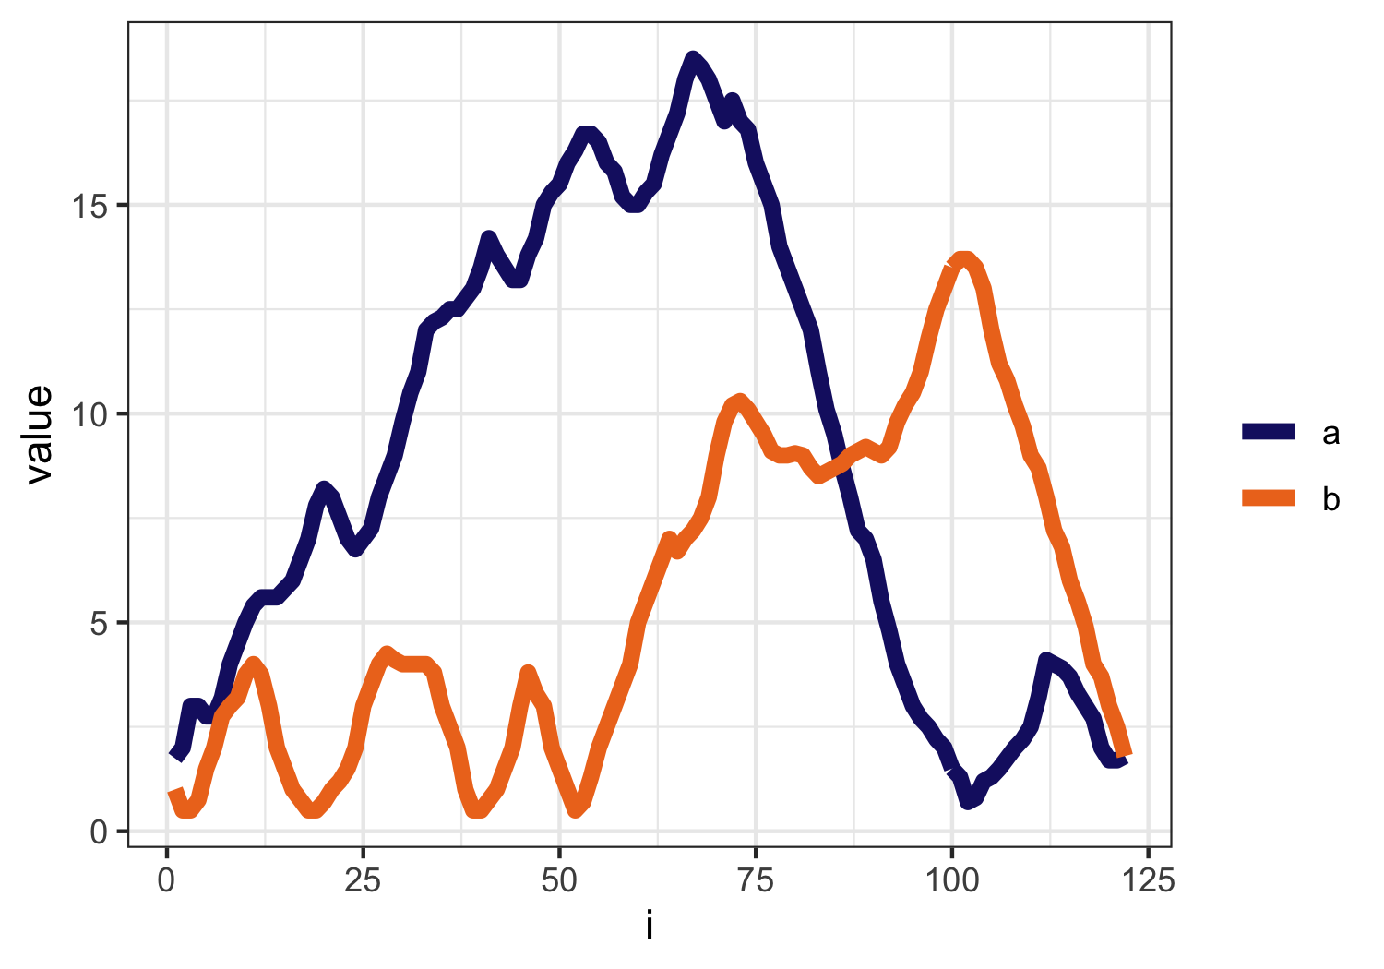
Notes:
Here we have graphed the variable i along the x axis and have plotted the variables A and B as lines. Looks nice, but maybe not the best way to show the relationship between A and B
What if instead of mapping the variable I to the x-axis, we mapped a to the X-axis and b to the Y-axis?

Slide 5
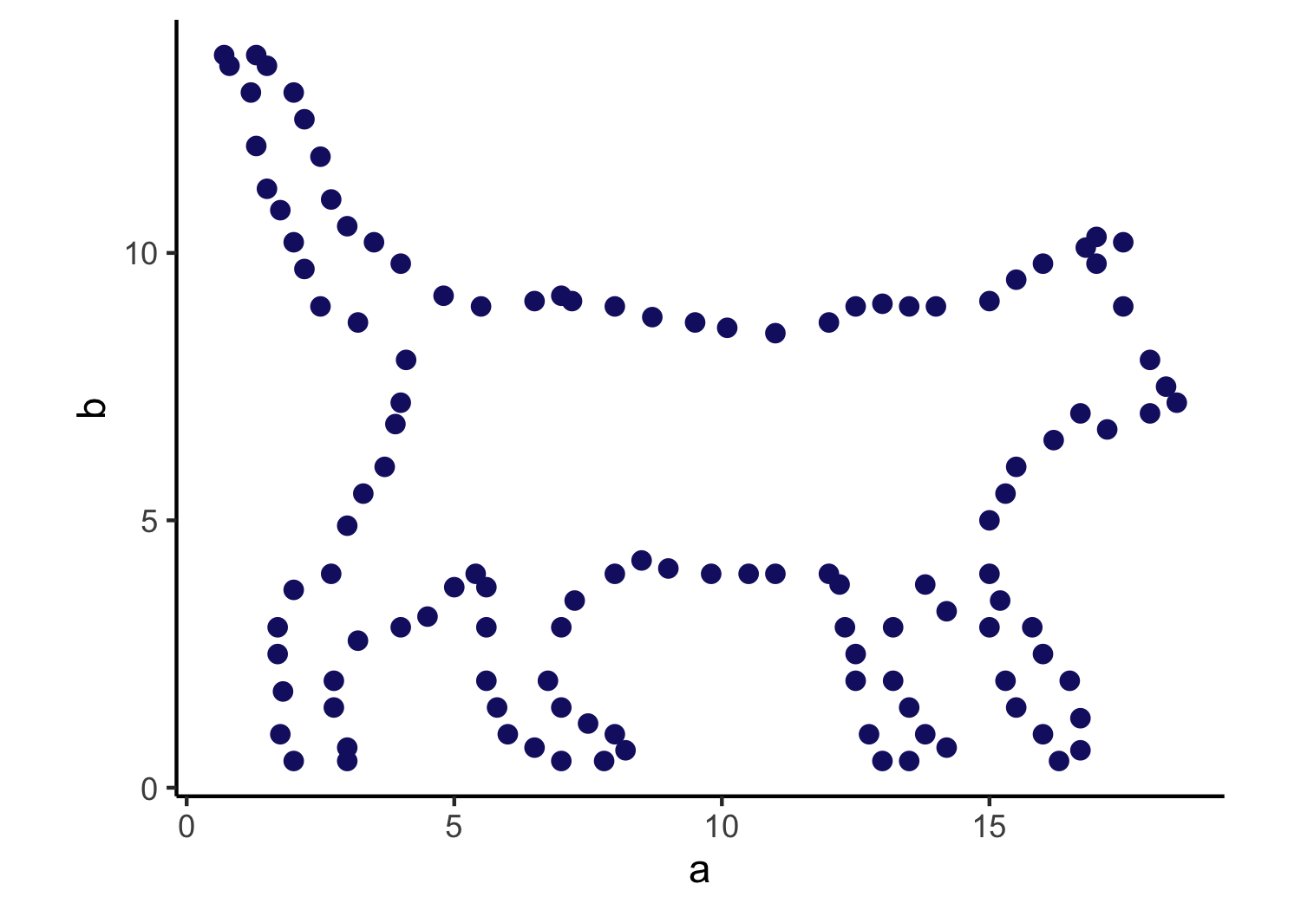
Notes:
AHA!
Pre-attentive processing – you see it before you think it. Subconscious accumulation of data
Best data viz makes use of pre-attentive processing of the effect that you want the audience to grasp

Slide 6
A graph is an encoding of the data
Your choice of encoding matters

Slide 7
Good data viz are optimized for use by the human visual system
Would be useful to know how that system works

Slide 8
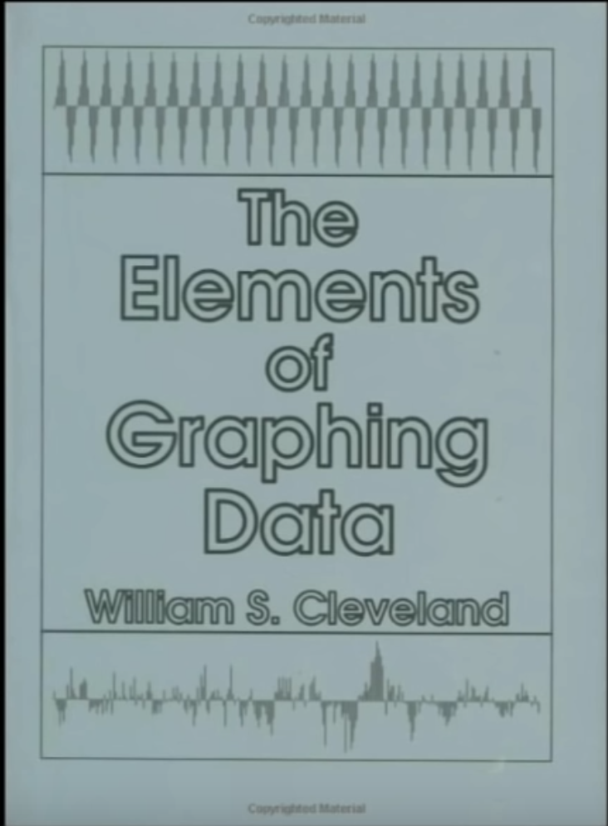
3 visual operations of pattern perception
Detection – recognition that geometric object encodes a physical value
Assembly – grouping of elements
Estimation – visual assessment of relative magnitude
Notes:
From William Cleveland

Slide 9
3 visual operations of pattern perception
Detection – recognition that geometric object encodes a physical value
Assembly – grouping of elements
Estimation – visual assessment of relative magnitude
Notes:
From William Cleveland

Slide 10
Estimation
Discrimination
Ranking
Ratioing
X = Y or X != Y
X < Y or X > Y
X / Y = ?
Comparison of data points is often the purpose of the viz
Edward Tufte: “At the heart of quantitative reasoning is a single question: Compared to what?”
Notes:
A data viz should enable the viewer to get as far down this list as possible with accuracy and efficiency

Slide 11
The most important comparsion should exploit the highest rank encoding:
Position on a common scale
Position on identical but misaligned scales
Length
Angle / slope
Area
Volume or density or color saturation
Color hue

Slide 12
The most important comparsion should exploit the highest rank encoding:
Position on a common scale
Position on identical but misaligned scales
Length
Angle / slope
Area
Volume or density or color saturation
Color hue

Slide 13

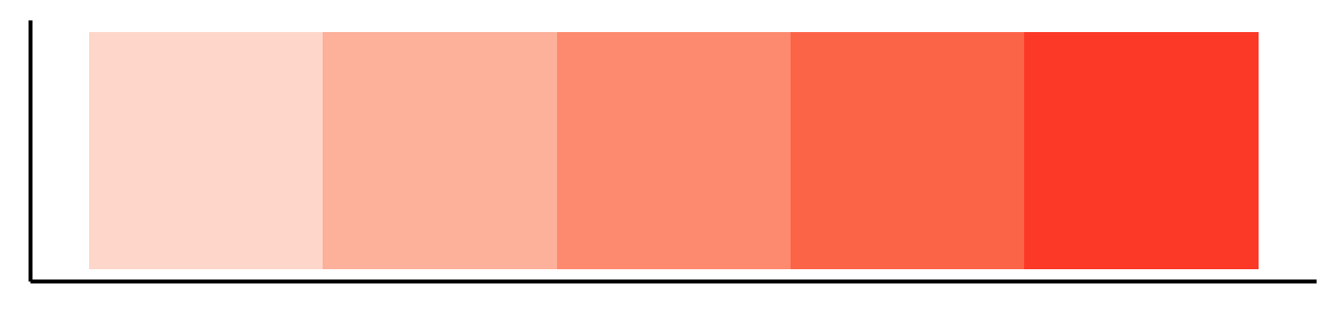
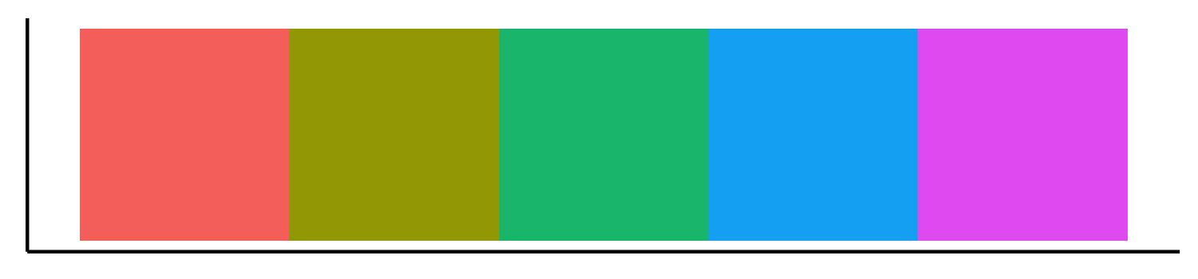
Color is really 3 things
Notes:
Luminance = brightness
Saturation = amount of color
Hue = color

Slide 14
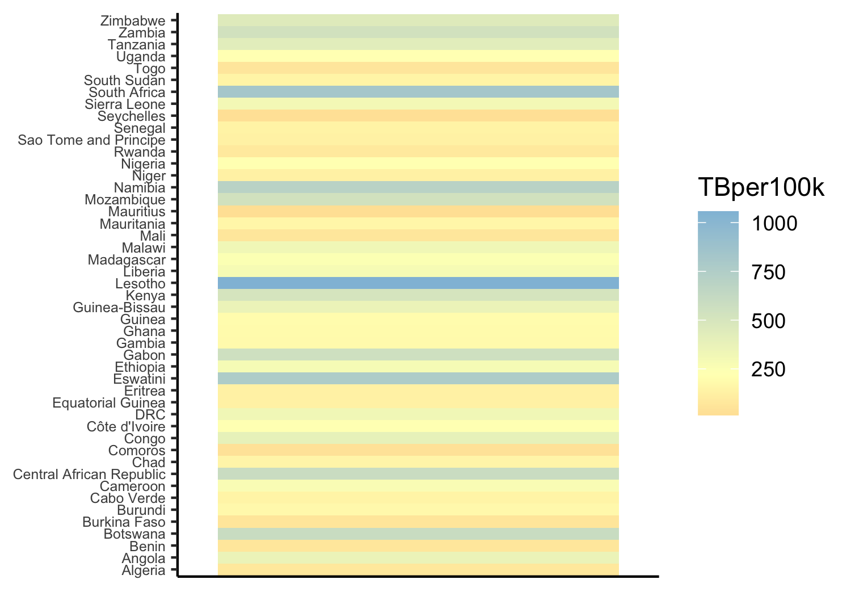
Notes:
HUE. Some of these you can do, but they are very slow because this is a table lookup. Hue does not inherently have an intuitive order.
If we use a hue scale that adds in luminance as an additional channel, so low luminance (dark) at bottom and high luminance (bright) at the top, that can already help to make the scale more understandable

Slide 15
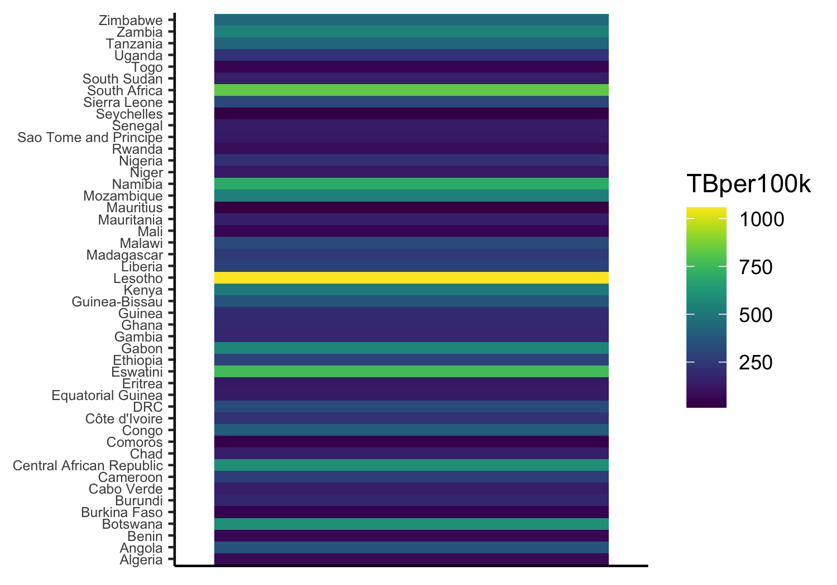
Notes:
HUE. Some of these you can do, but they are very slow because this is a table lookup. In general, hue does not have a natural order but this color scale from dark blue to bright yellow makes use of luminance too so that helps our eye establish an intuitive hierarchy

Slide 16
Alphabetical order is almost never the correct order

Slide 17
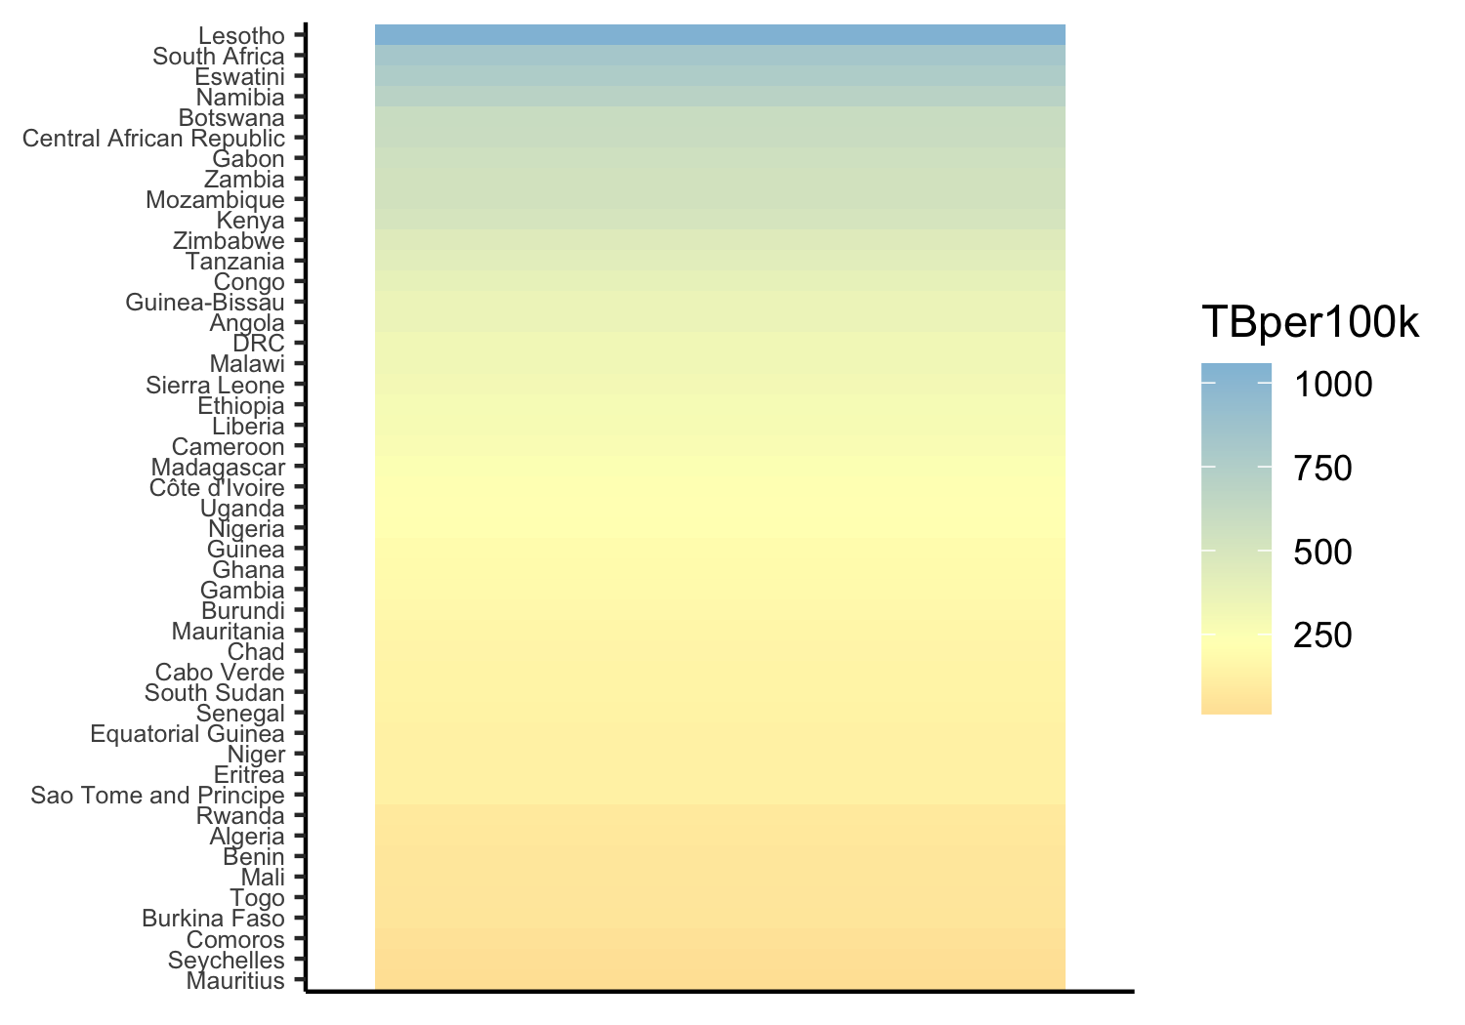

Slide 18
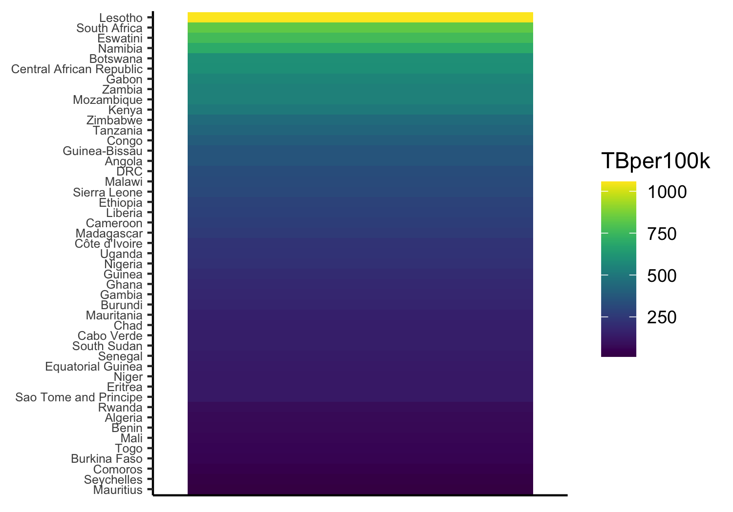

Slide 19
The most important comparsion should exploit the highest rank encoding:
Position on a common scale
Position on identical but misaligned scales
Length
Angle / slope
Area
Volume or density or color saturation
Color hue

Slide 20
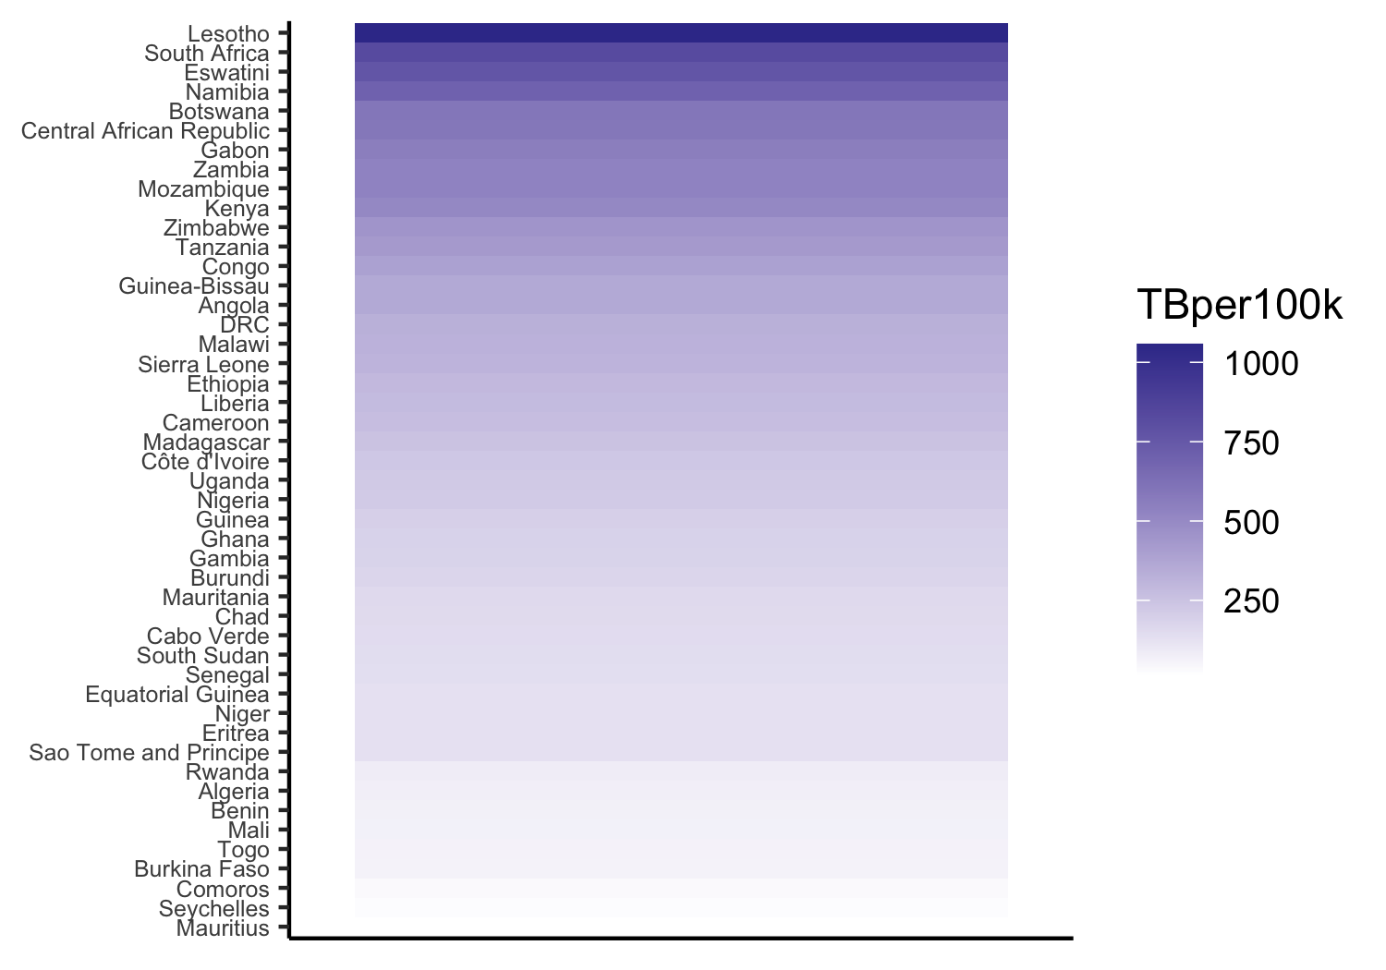
Notes:
Natural order of saturation. Without legend you are still fine to guess the order. Can start to do ratioing (provided 0 color = 0 mpg)

Slide 21
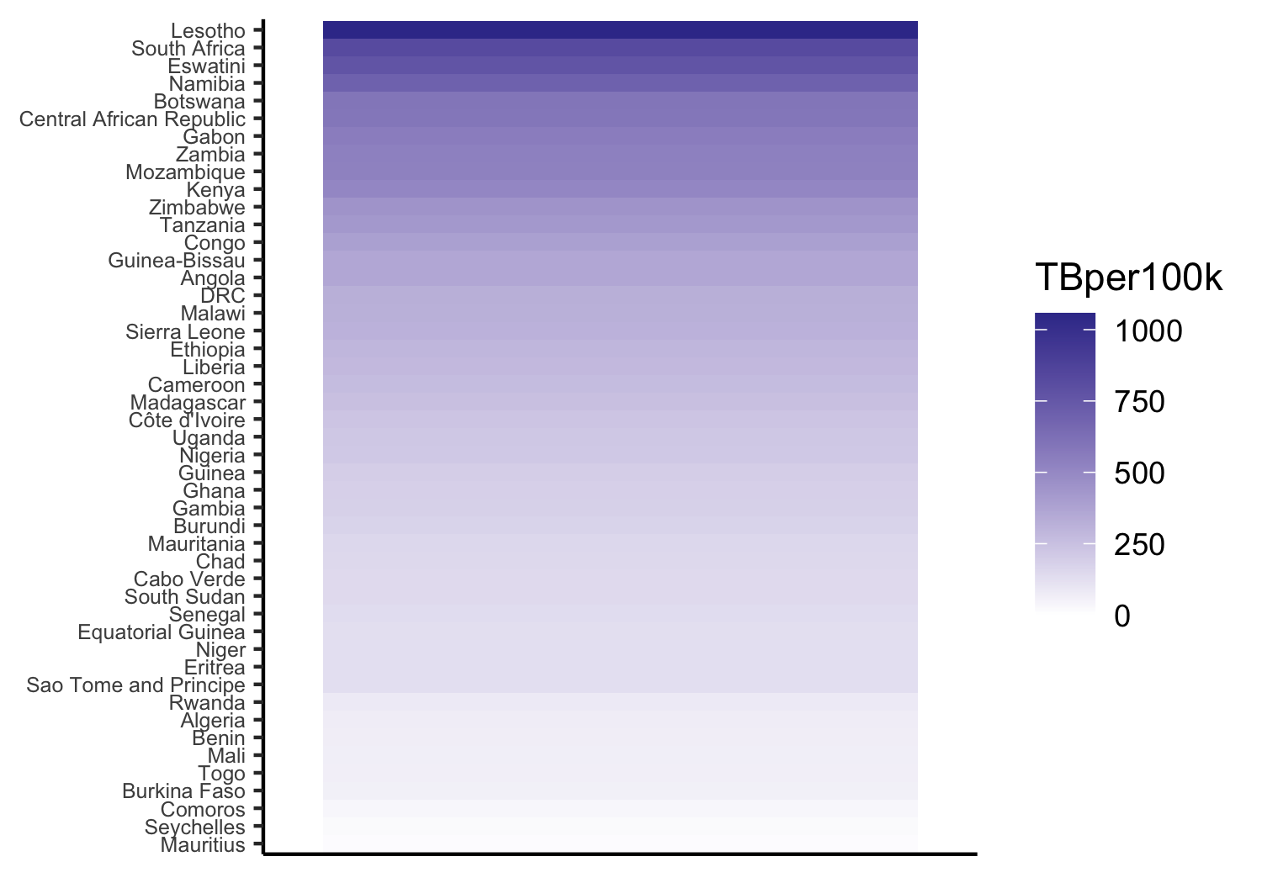
Notes:
I slightly altered the previous plot so that the zero TB means zero saturatuion, which is how we intuitively want to read that saturation legend. Maritius is Can start to do ratioing (provided 0 color = 0 TB).

Slide 22
The most important comparsion should exploit the highest rank encoding:
Position on a common scale
Position on identical but misaligned scales
Length
Angle / slope
Area
Volume or density or color saturation
Color hue

Slide 23
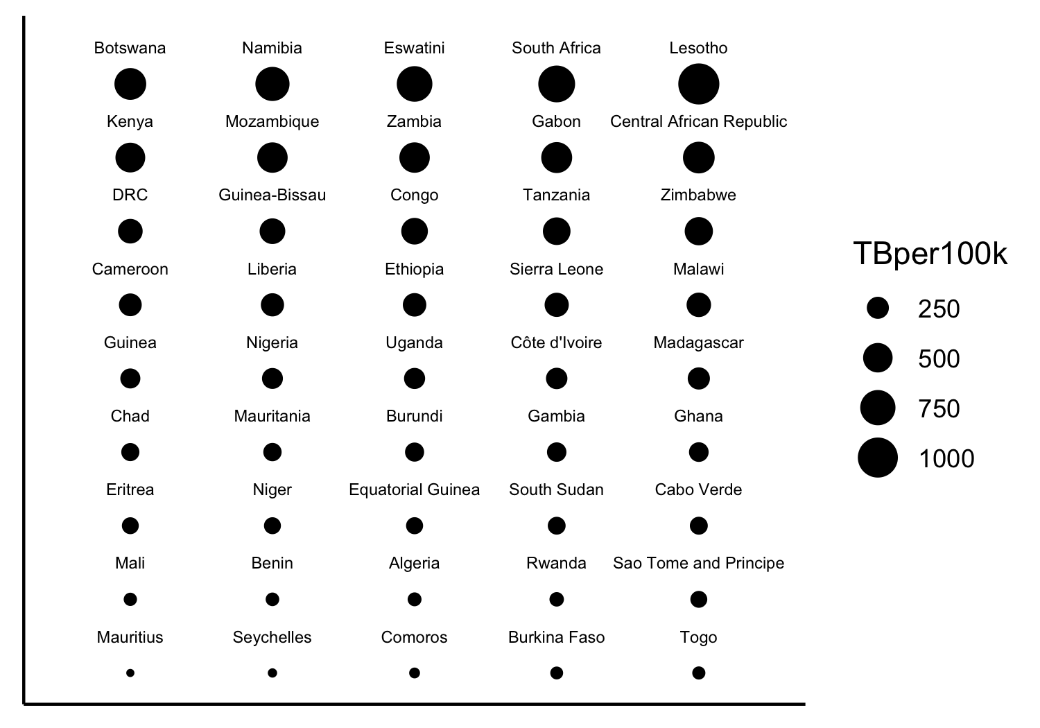
Notes:
AREA. Ratioing is possible with 2D area. Needs to be done right though! Scaled the AREA (not the radius or diameter). Scaled so that 0TB = 0area

Slide 24
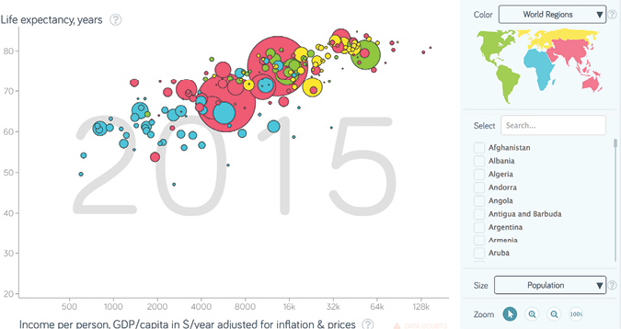
Notes:
Hans Rosling gapminder dataset

Slide 25
The most important comparsion should exploit the highest rank encoding:
Position on a common scale
Position on identical but misaligned scales
Length
Angle / slope
Area
Volume or density or color saturation
Color hue

Slide 26
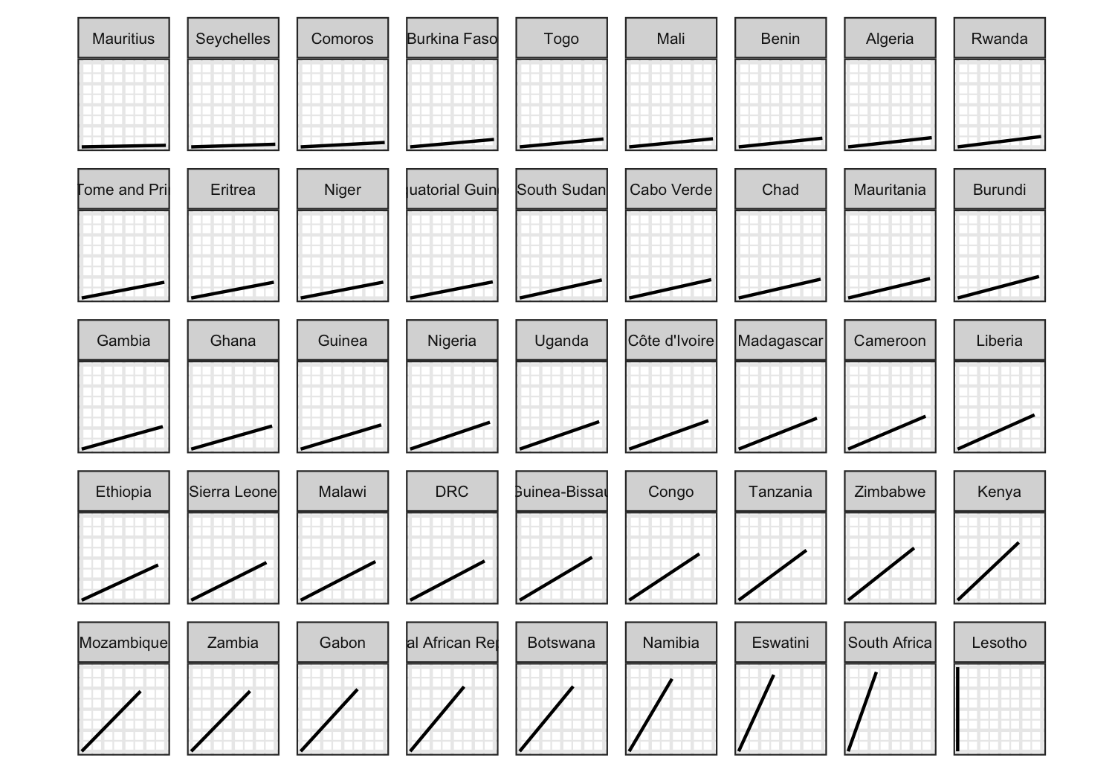
Notes:
Horizontal = 0mpg and vertical = max in dataset
Cadilac is 1/3 as efficient as Corolla and ½ as efficient as Datsun710

Slide 27
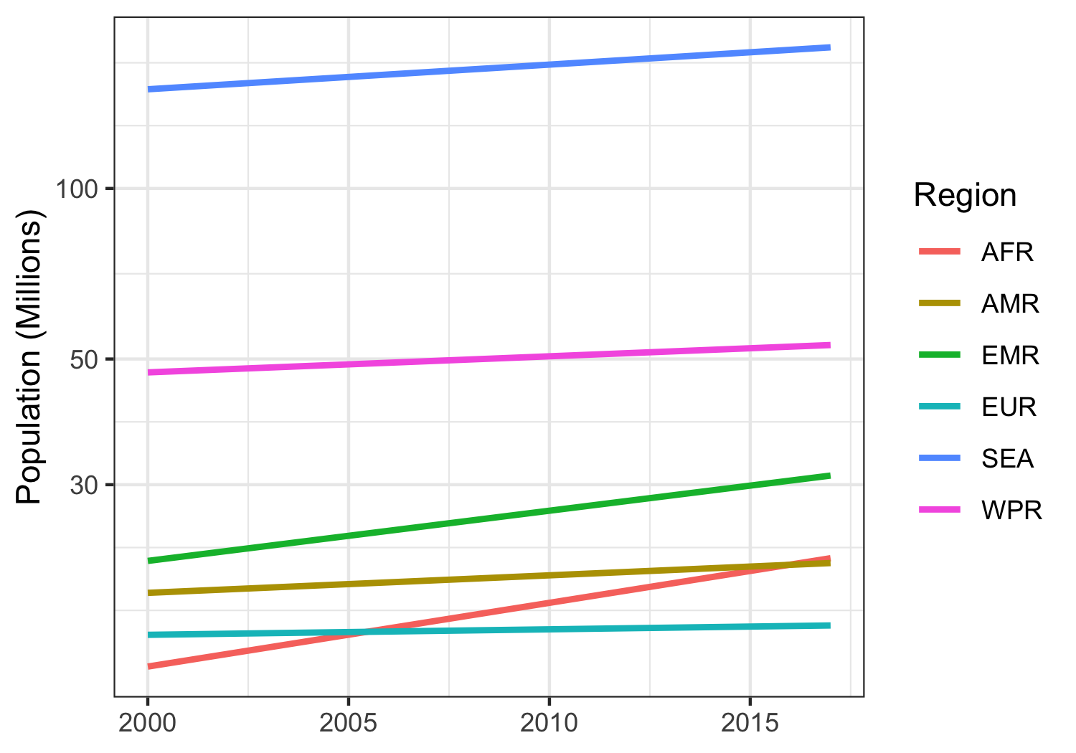
Notes:
Pop growth is encoded as angle
Is the Eastern Mediterranean region growing faster or slower than South East Asia? – Faster?? But it is hard to tell because the lines are far from each other

Slide 28
The most important comparsion should exploit the highest rank encoding:
Position on a common scale
Position on identical but misaligned scales
Length
Angle / slope
Area
Volume or density or color saturation
Color hue

Slide 29
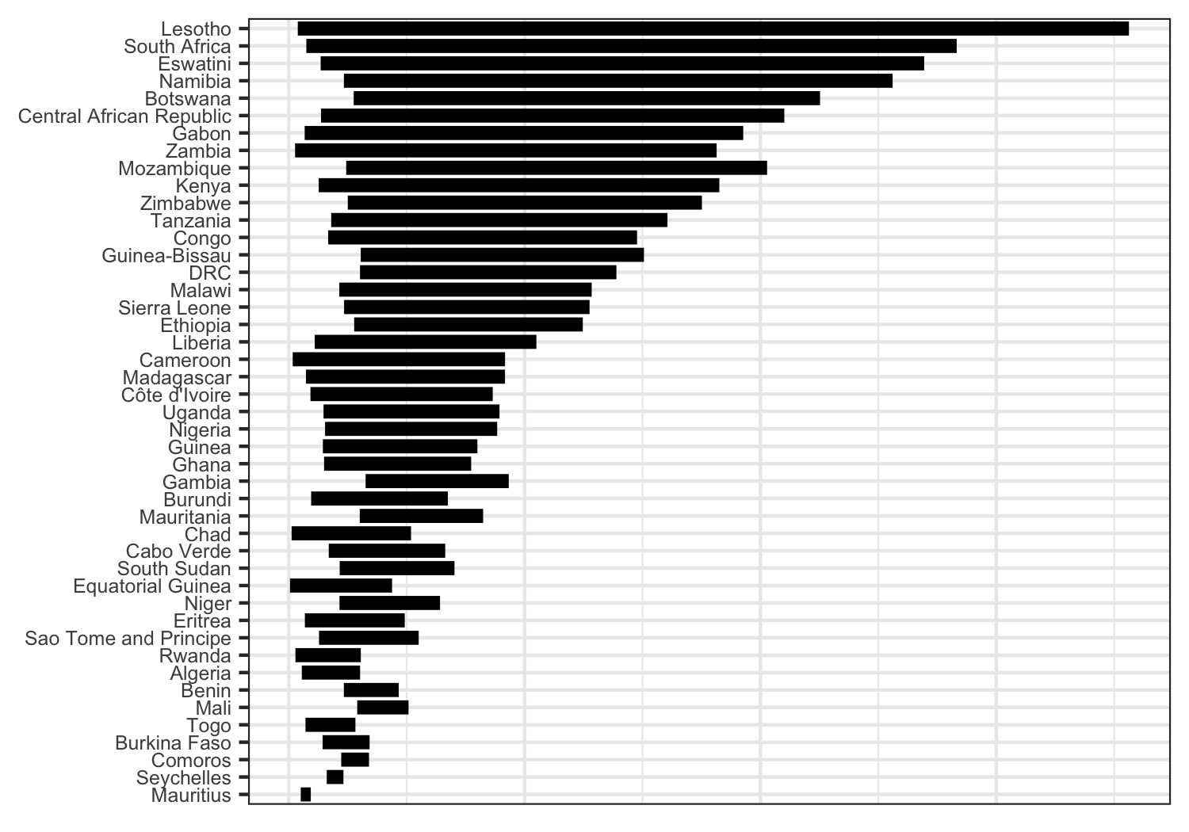
200 cases of TB per 100K
Notes:
Can get accurate ratioing – better than angle or area
Togo looks to be about double Comoros
BUT – discrimination is still tough
Are Eritrea and Sao Tome & Principe same or different? – hard to tell because not on common baseline

Slide 30
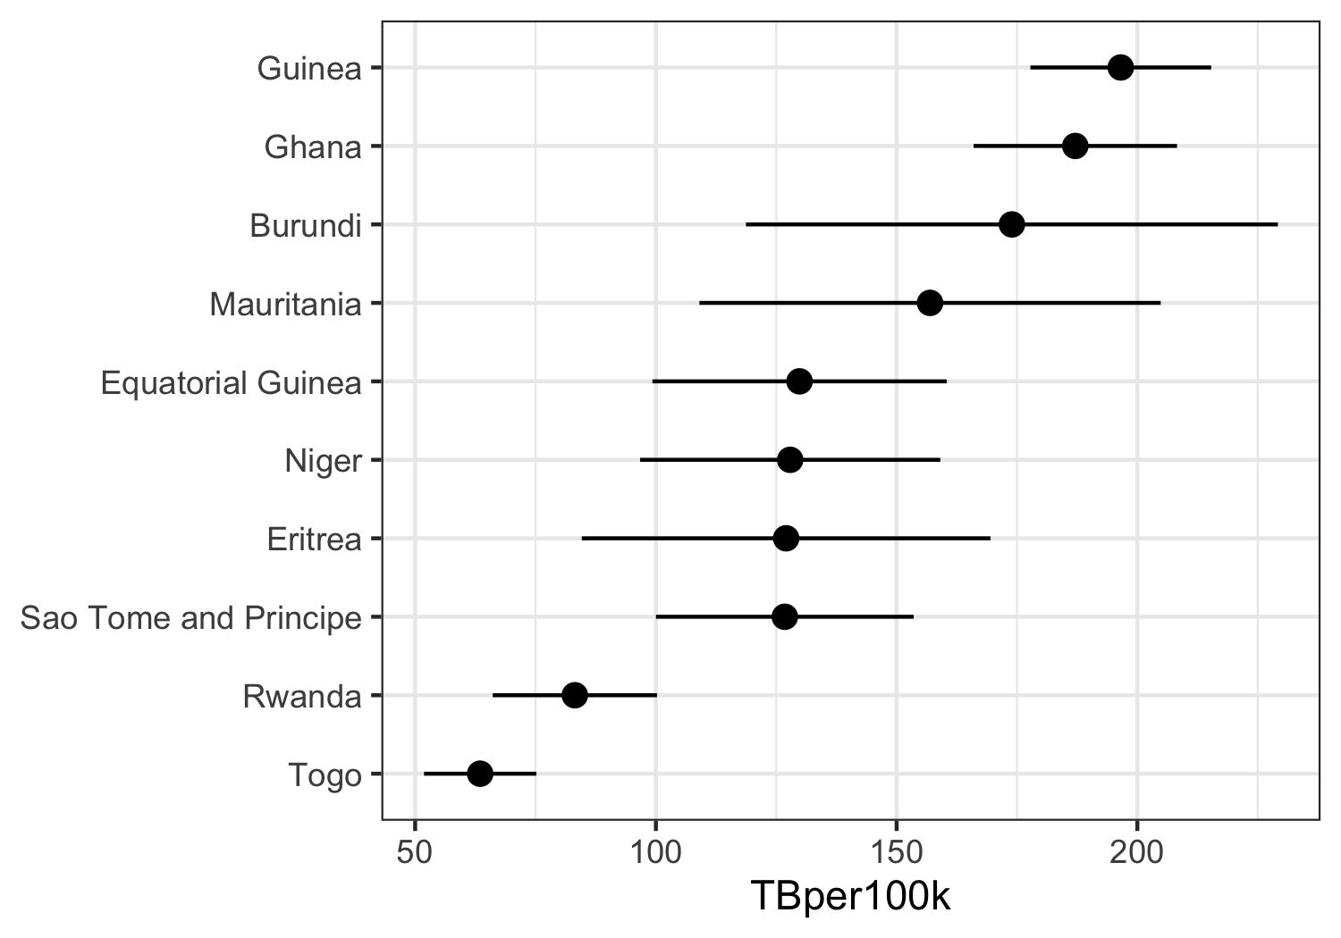
Notes:
Length of unaligned line segments is actually common
Comparing error of Ghana with that of Rwanda is difficult though that is exactly what we are asking viewers to do

Slide 31
The most important comparsion should exploit the highest rank encoding:
Position on a common scale
Position on identical but misaligned scales
Length
Angle / slope
Area
Volume or density or color saturation
Color hue

Slide 32
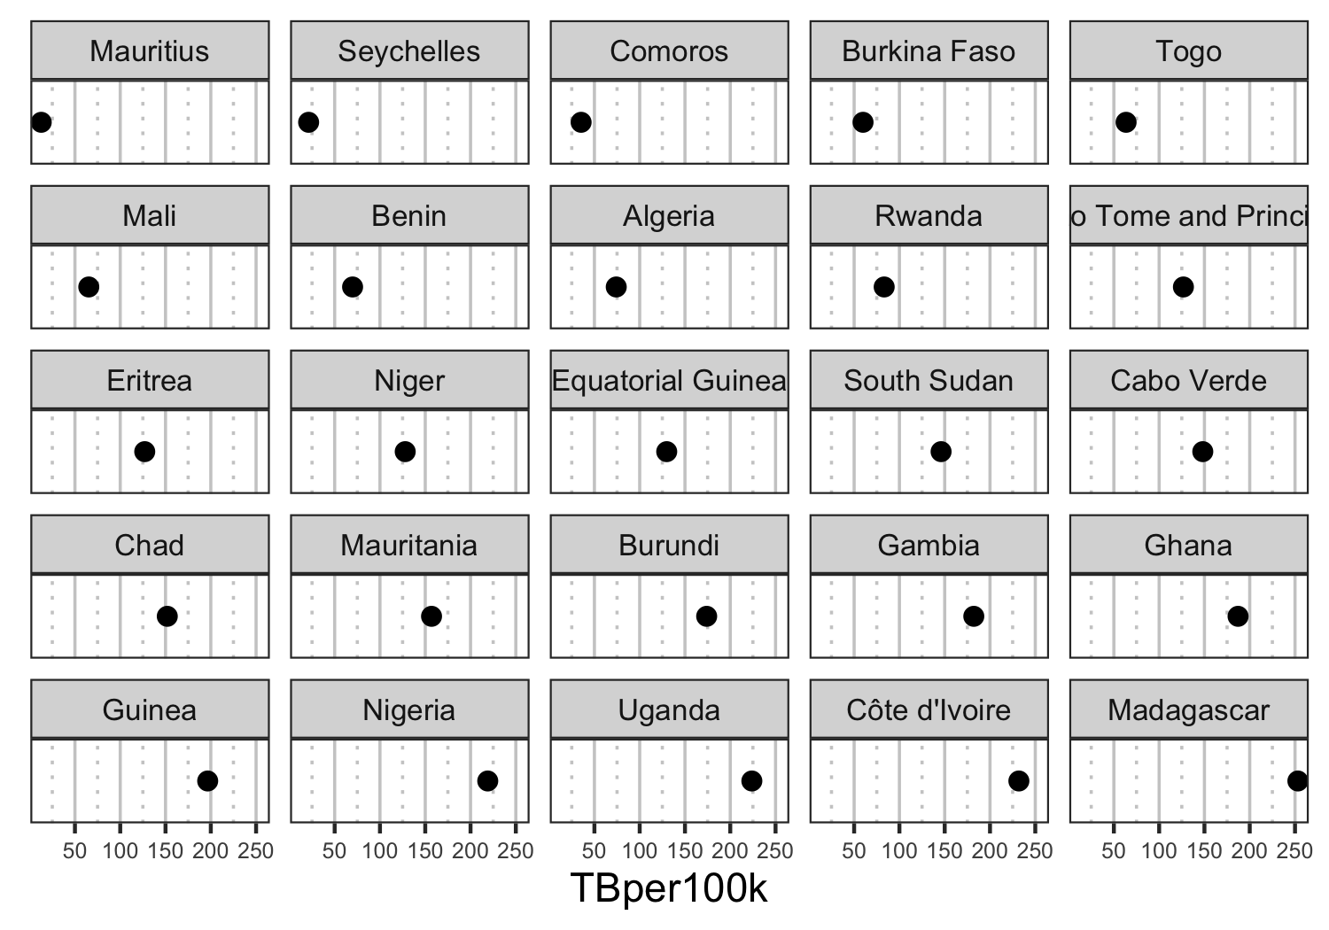
Notes:
Now we can tell diff between two very close values. Comoros is below 50 while Togo is above. In this case gridlines are extremely important to our ability to detect the differences

Slide 33
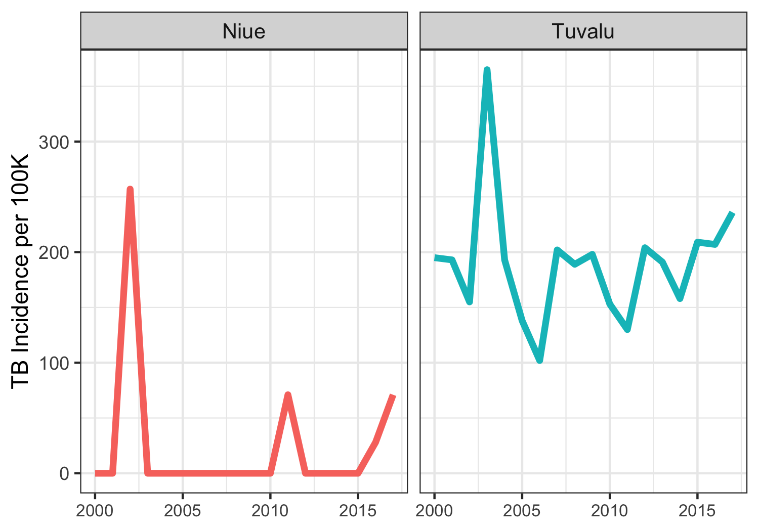
Notes:
Is the peak in the same years in each of these two countries? We can tell that Tuvalu has its peak after Niue but it requires two lookups

Slide 34
The most important comparsion should exploit the highest rank encoding:
Position on a common scale
Position on identical but misaligned scales
Length
Angle / slope
Area
Volume or density or color saturation
Color hue

Slide 35
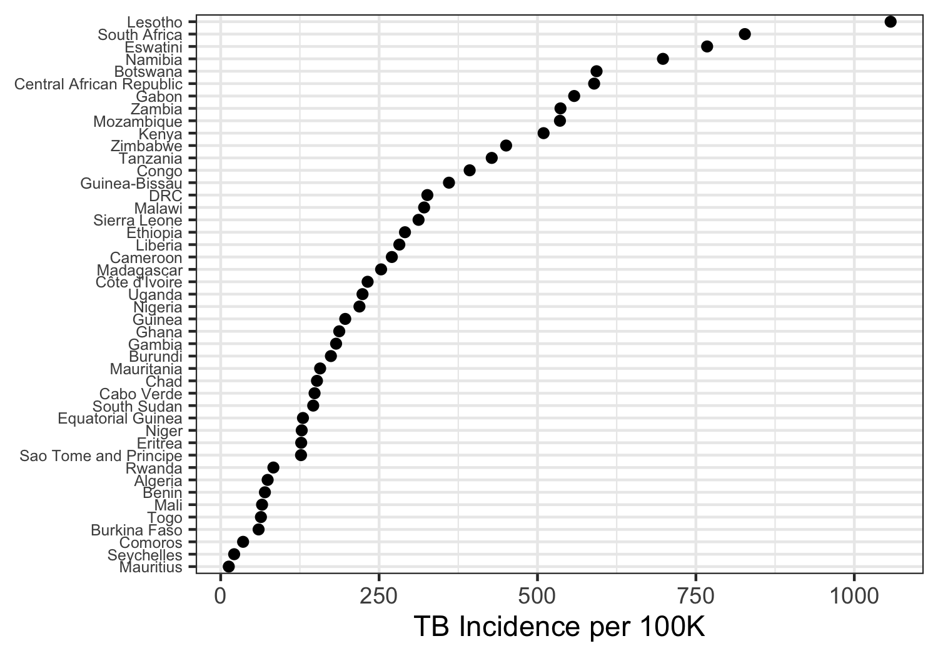
Notes:
Ratioing, ranking, and discrimination are easy!

Slide 36
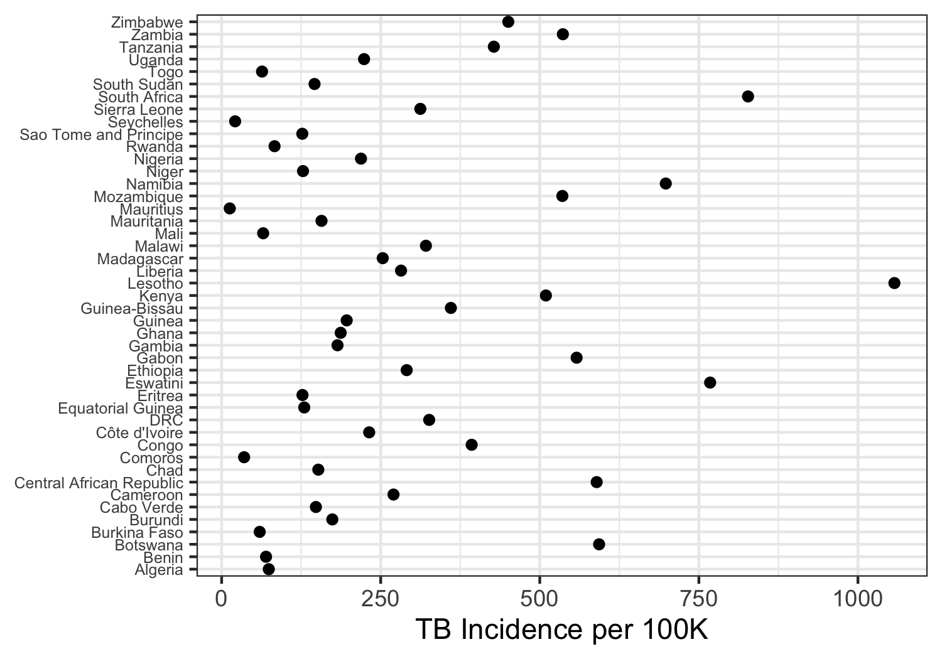
Notes:
Remember that ordering is still critical

Slide 37
Be careful with stacking

Slide 38
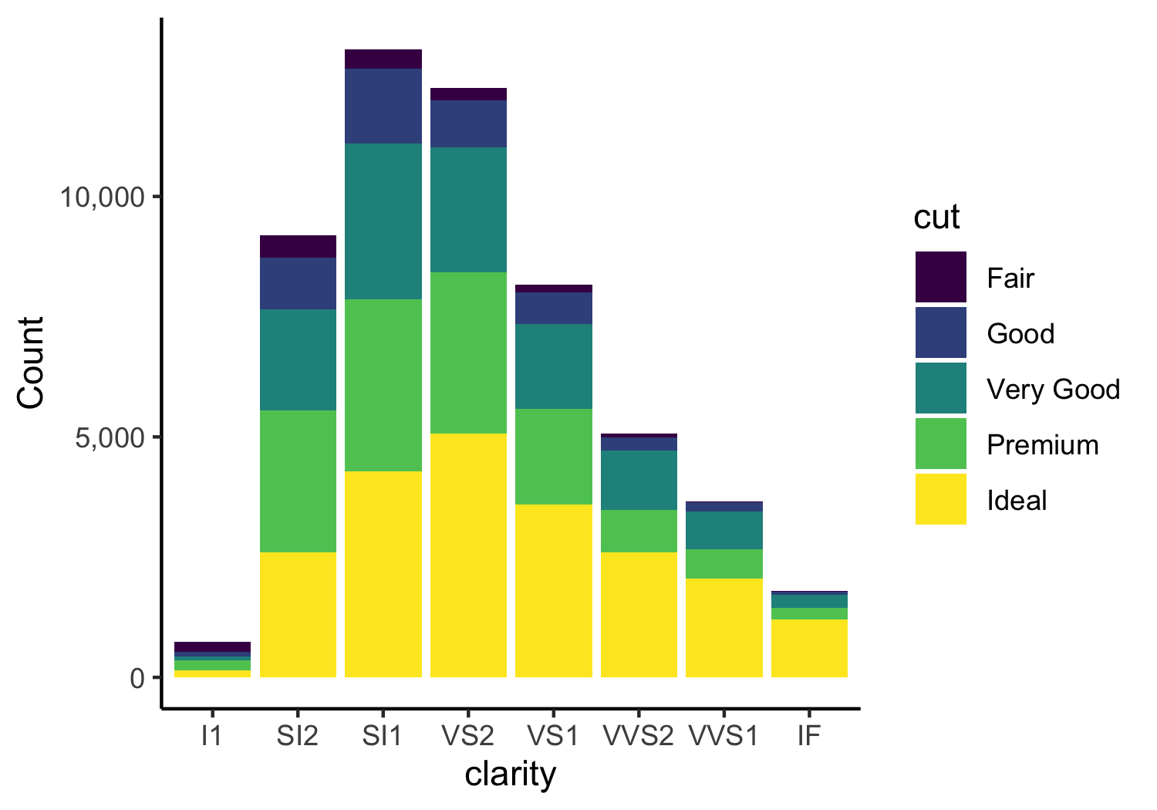
Notes:
This plot most easily shows the number of diamonds in each clarity class (length of bars)
But the count within cut/clarity combo is hard. Are there more diamonds in the Premium cut class in the SI2 or SI1 clarity group? We can’t tell
Why?
Because decoding lengths on misaligned scales is harder than decoding lengths on a common scale

Slide 39
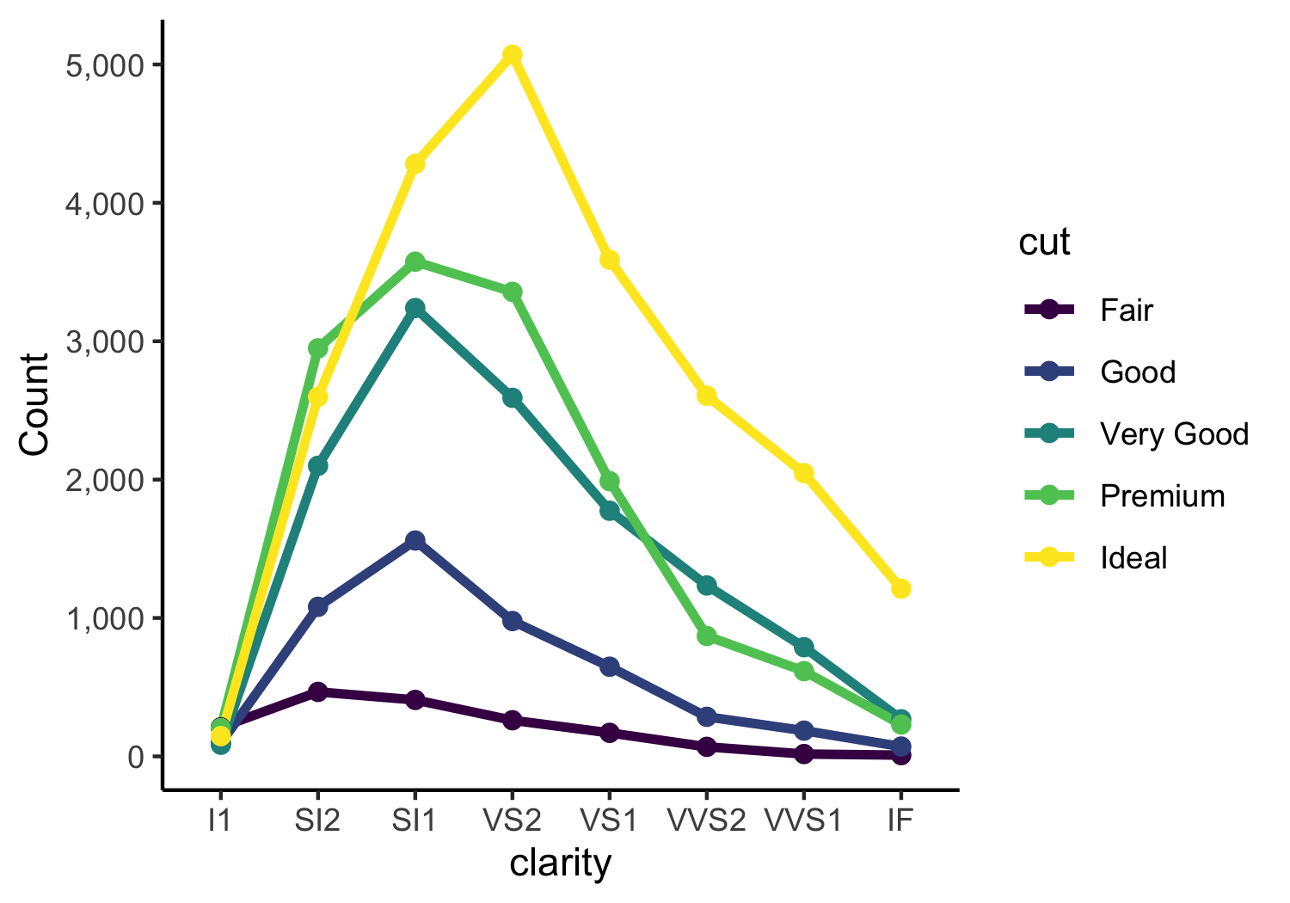
Notes:
Parallel coordinates plot encodes the count of each clarity/cut class as the position on a common scale
You have lost info about totals in each clarity group, so add that in as a separate line or separate plot if you need that info

Slide 40
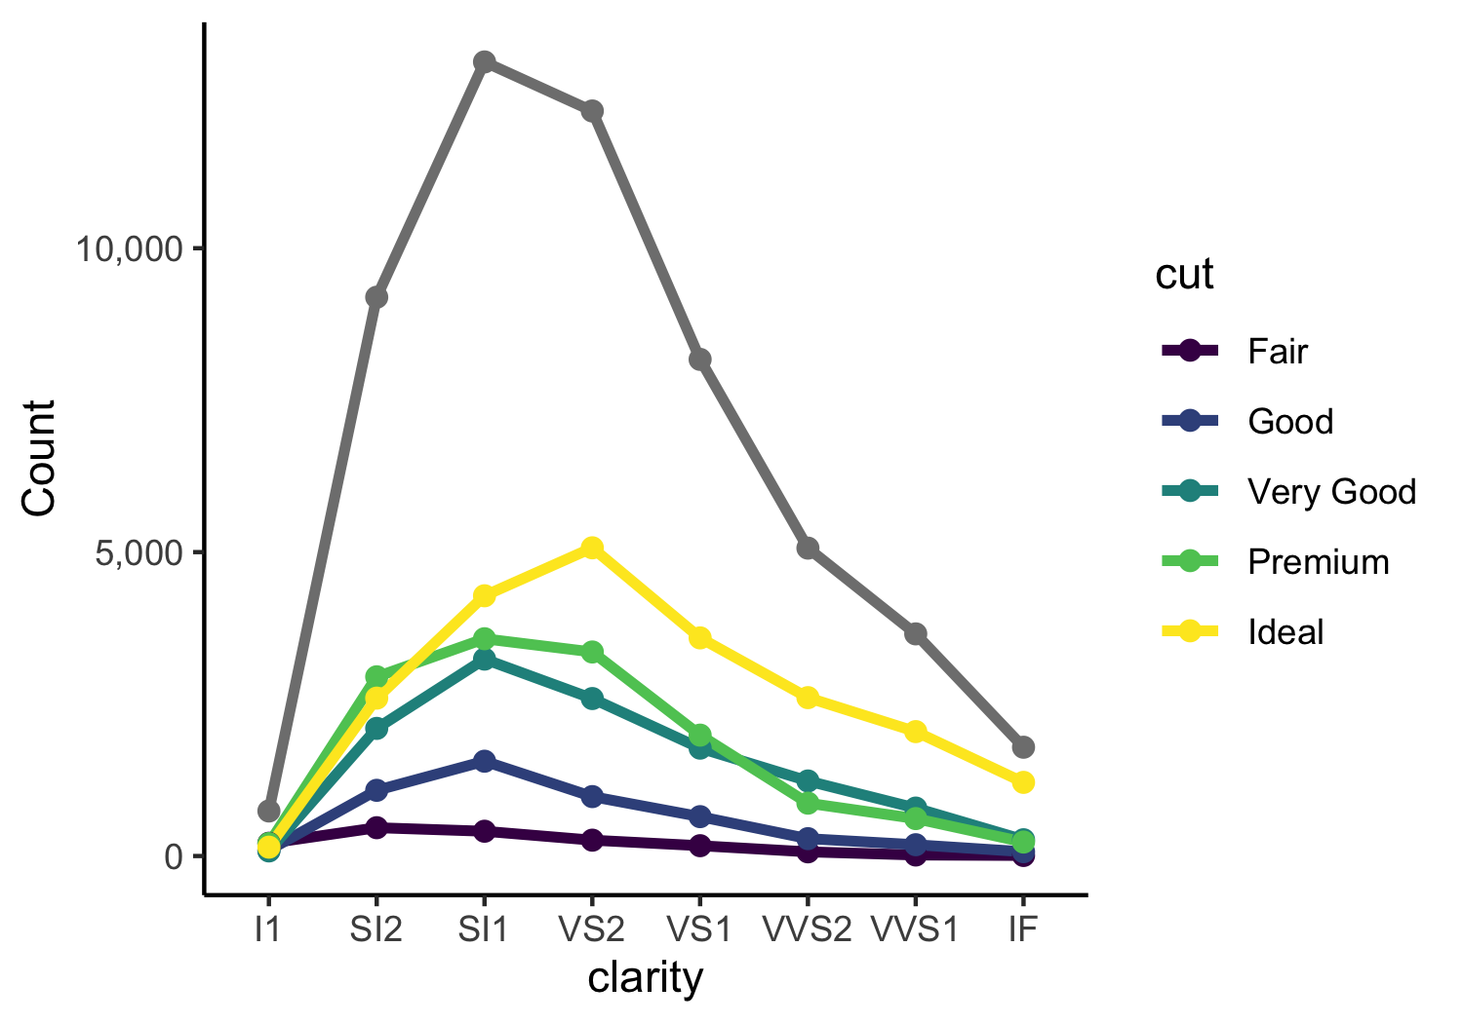

Slide 41
Pie charts are always a mistake
Use a table instead (for data with few categories)
Use a dot plot (for data with lots of categories)
Notes:
Encode information as angles (4th on the list)

Slide 42
Notes:
This lovely pie chart shows the proportion of the world’s population in each of the different regions in the tuberculosis dataset. This is not any better than a table.

Slide 43
Notes:
Certainly the donut should be avoided since now the area of a complex shape encodes the proportion of the population

Slide 44
Region | Proportion
WPR | 0.26
SEA | 0.26
AMR | 0.14
EUR | 0.13
AFR | 0.12
EMR | 0.09

Slide 45
Notes:
Certainly, this information (population proportion for 218 countries) must be in a table or summarized in a different way

Slide 46
3 visual operations of pattern perception
Detection – recognition that geometric object encodes a physical value
Assembly – grouping of elements
Estimation – visual assessment of relative magnitude
Notes:
From William Cleveland

Slide 47
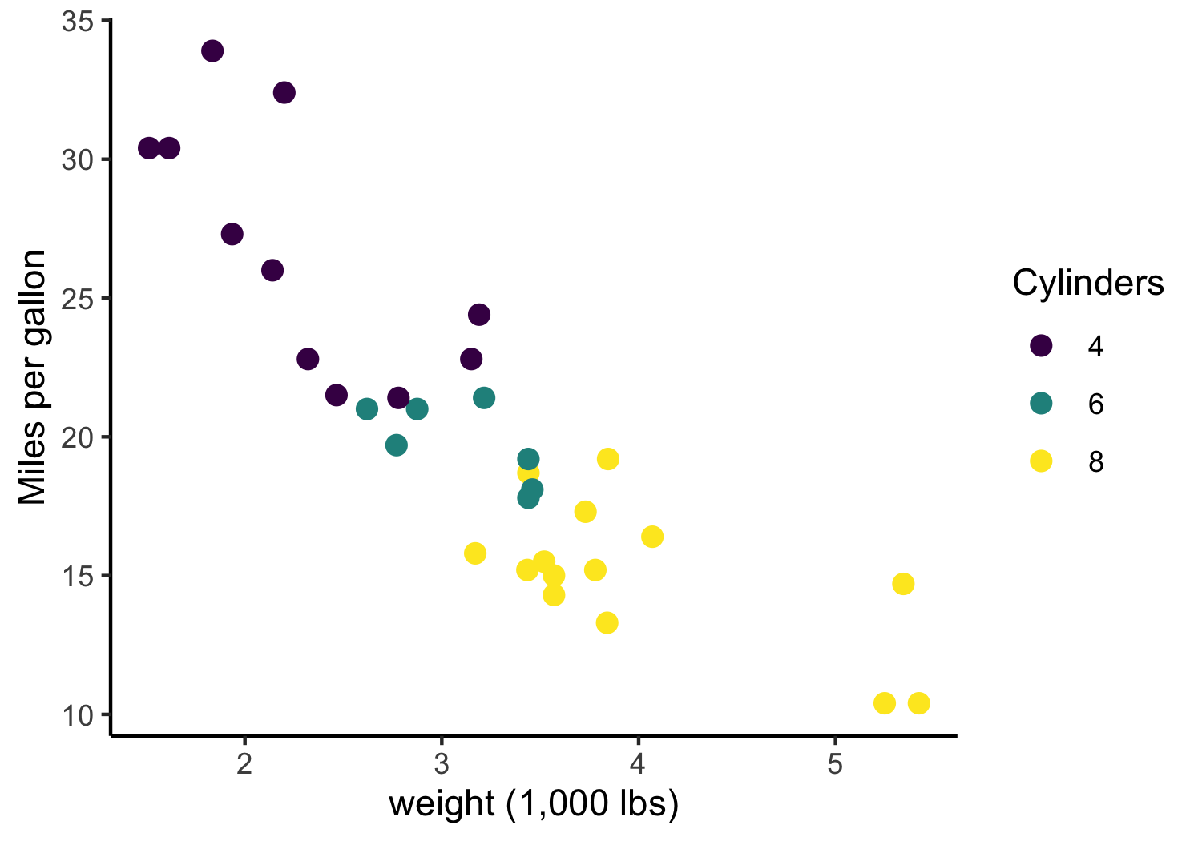
Notes:
Because of ASSEMBLY we easily perceive the colors as groups
Law of Similarity – we tend to see elements that are physically similar to each other as parts of the same object

Slide 48
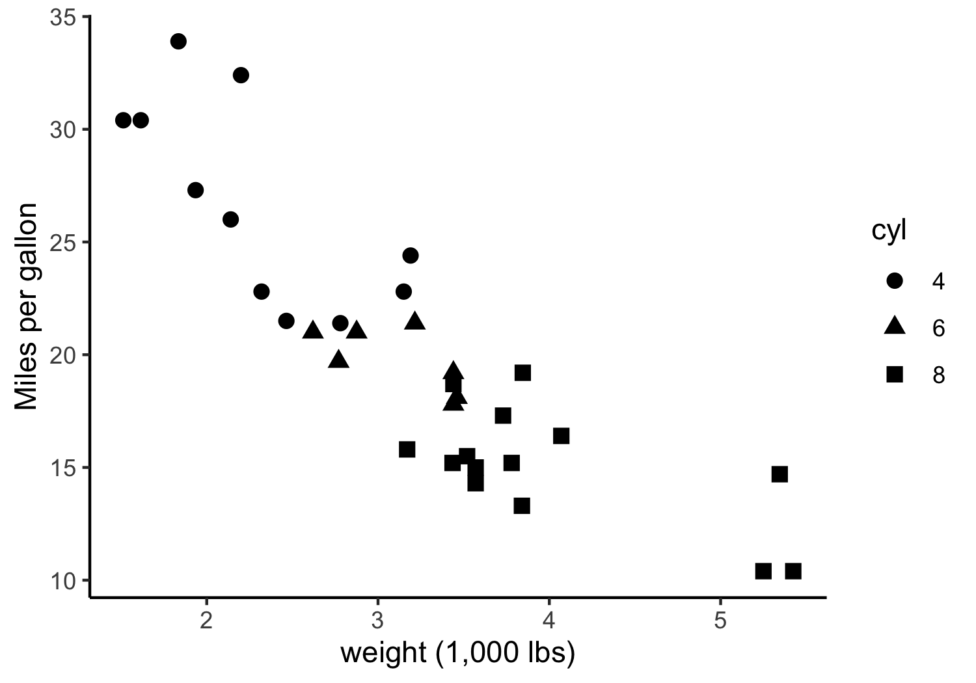
Notes:
Shape doesn’t work as well in this case because the differences in the shapes are difficult to perceive

Slide 49
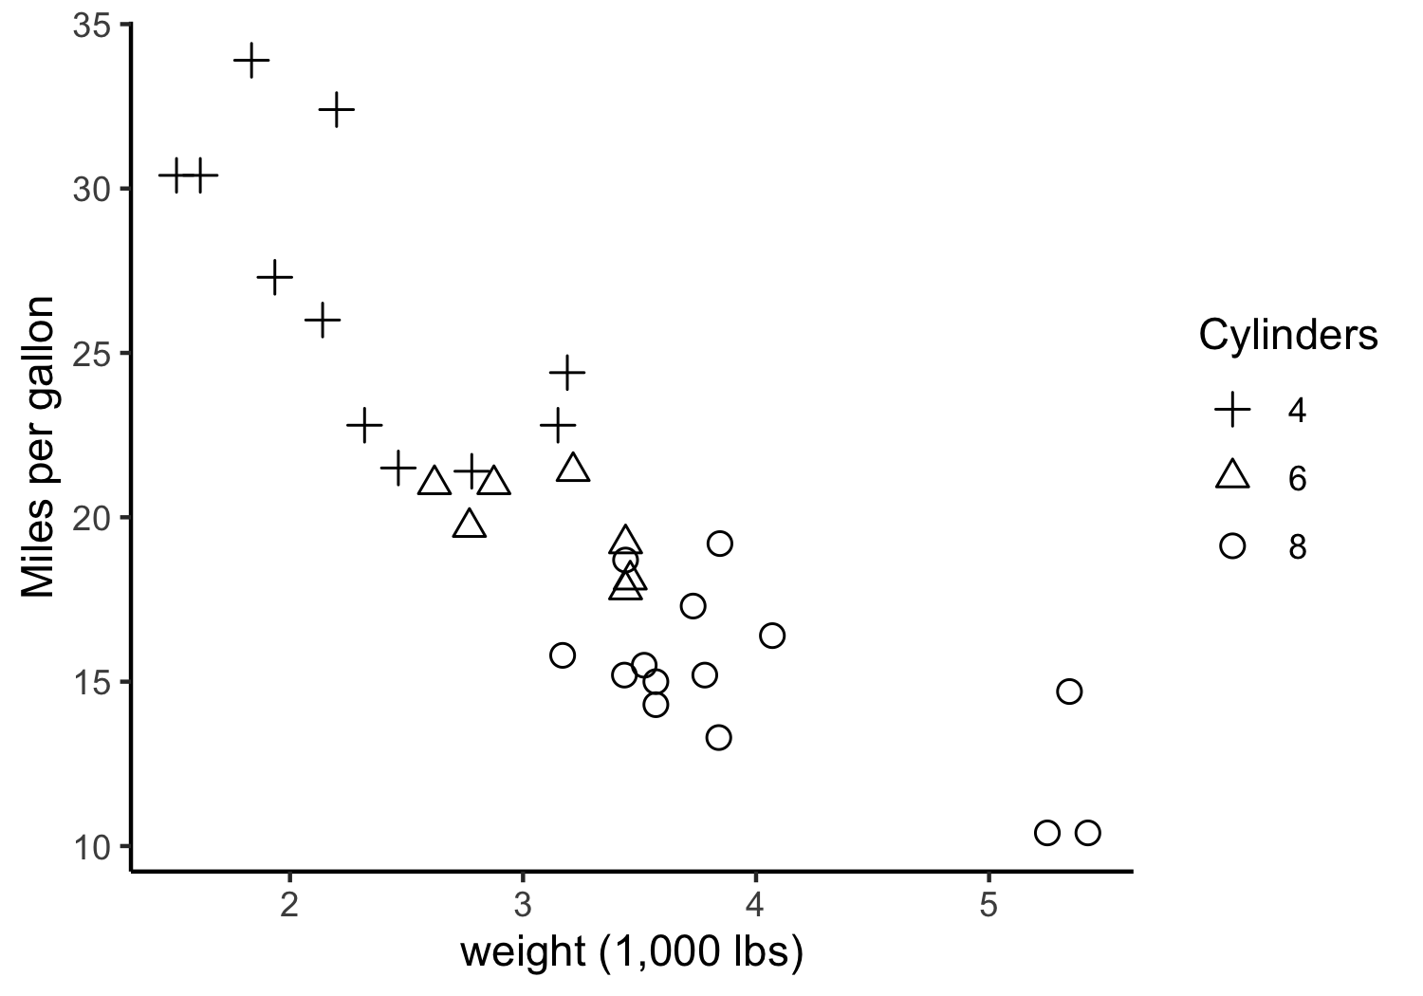
Notes:
But these shapes are pretty effective because they look so different from one another
Human eyes are really good at detecting curvature

Slide 50
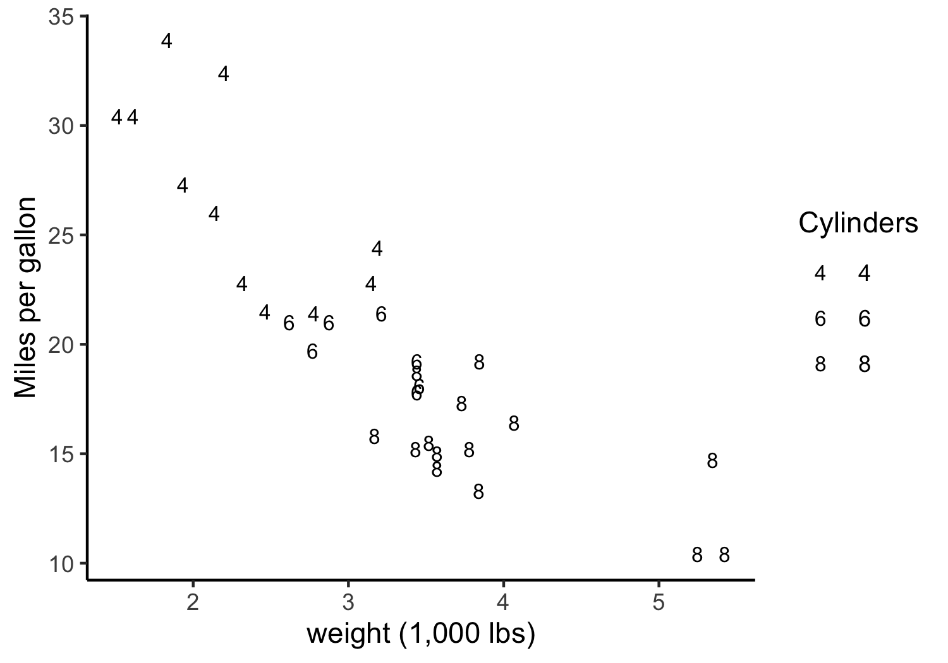
Notes:
You'd think this would be a great encoding, but it's terrible because of the similar curvature of the sixes and eights.

Slide 51
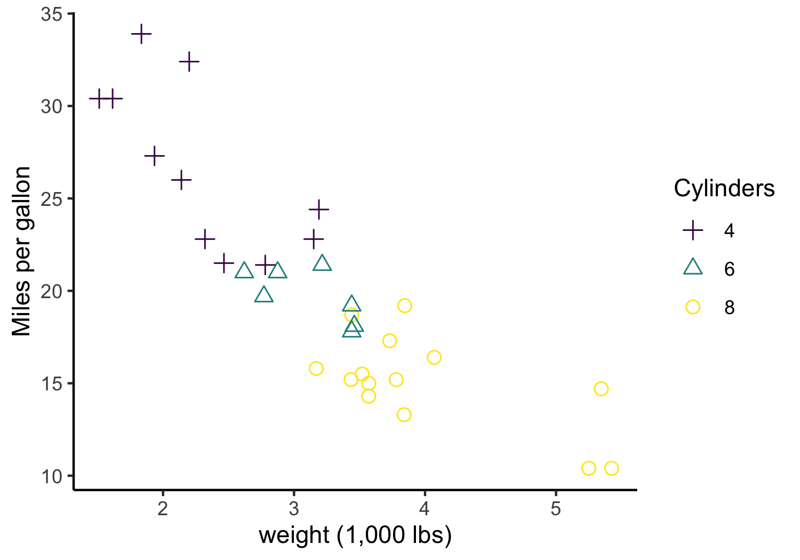
Notes:
Encode same info in two channels – hue and angle

Slide 52
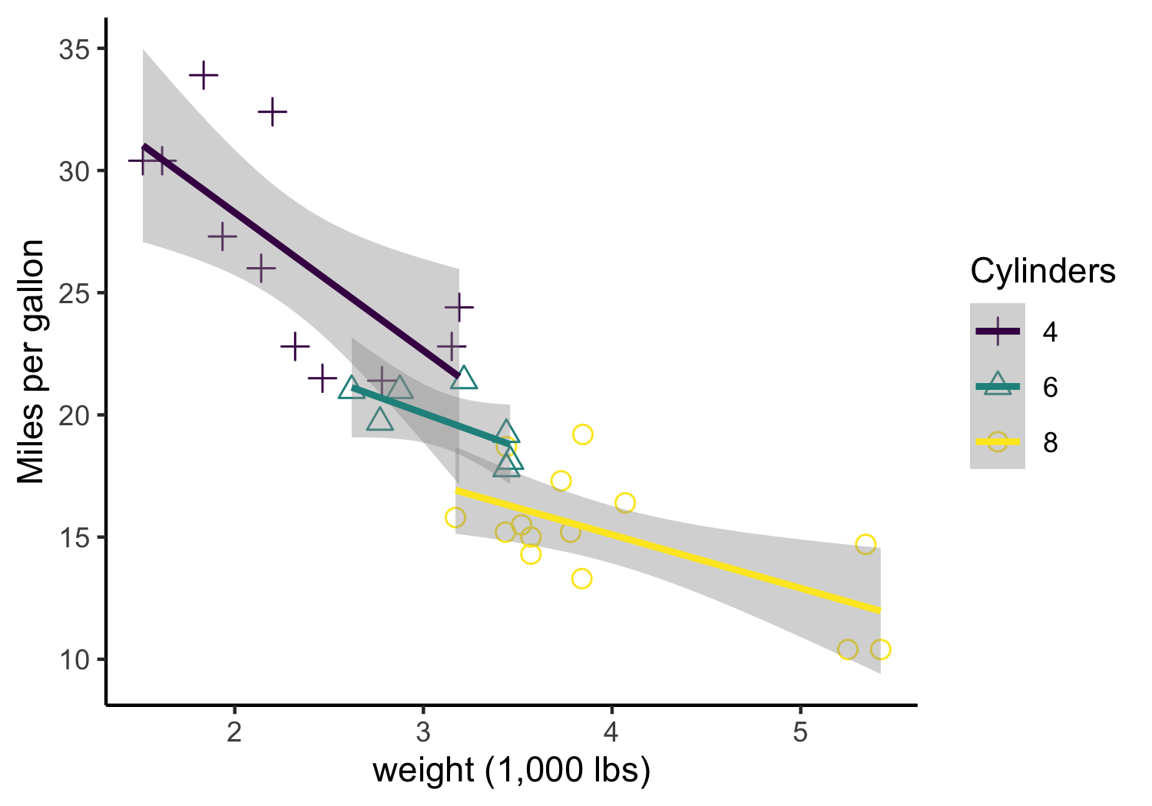
Notes:
Overlaying linear fits encloses space and makes the grouped objects very strong.

Slide 53
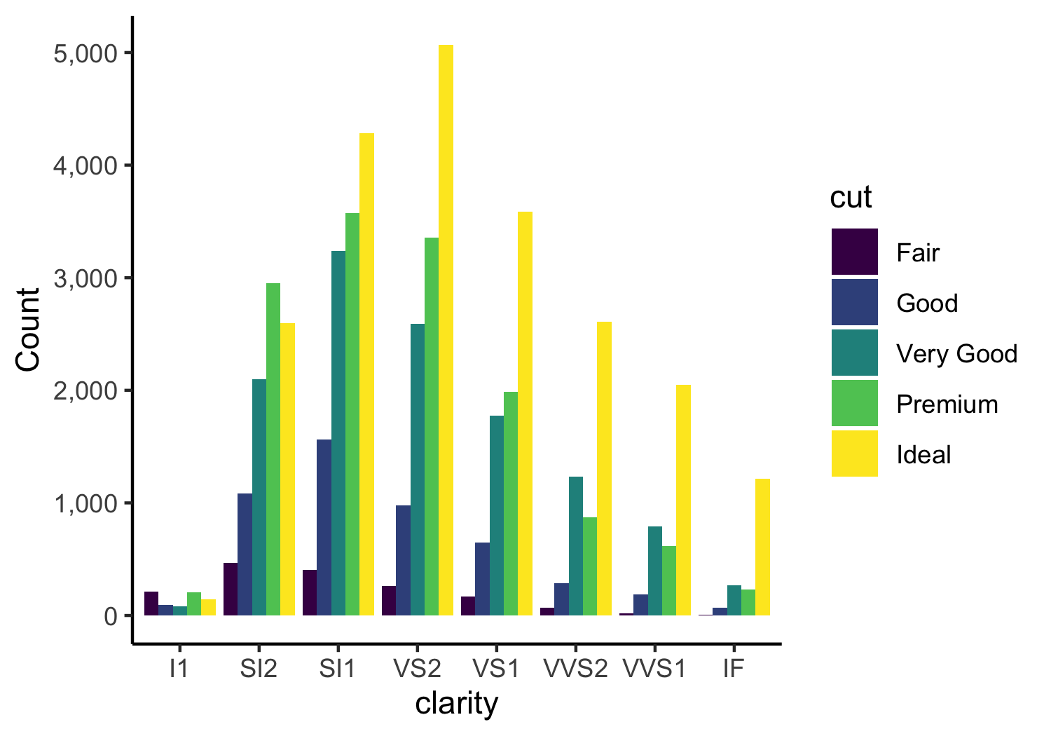
Notes:
Law of Proximity encourages our eyes to make 8 groupings here, one for each clarity class.
Difficult to tell how diamonds of “Good” cut change over clarity v. how diamonds of “Premium” cut change over clarity

Slide 54
Notes:
This is better since it helps our eye group by cut and then comparisons by clarity are made via the common scale

Slide 55
3 visual operations of pattern perception
Detection – recognition that geometric object encodes a physical value
Assembly – grouping of elements
Estimation – visual assessment of relative magnitude
Notes:
From William Cleveland

Slide 56
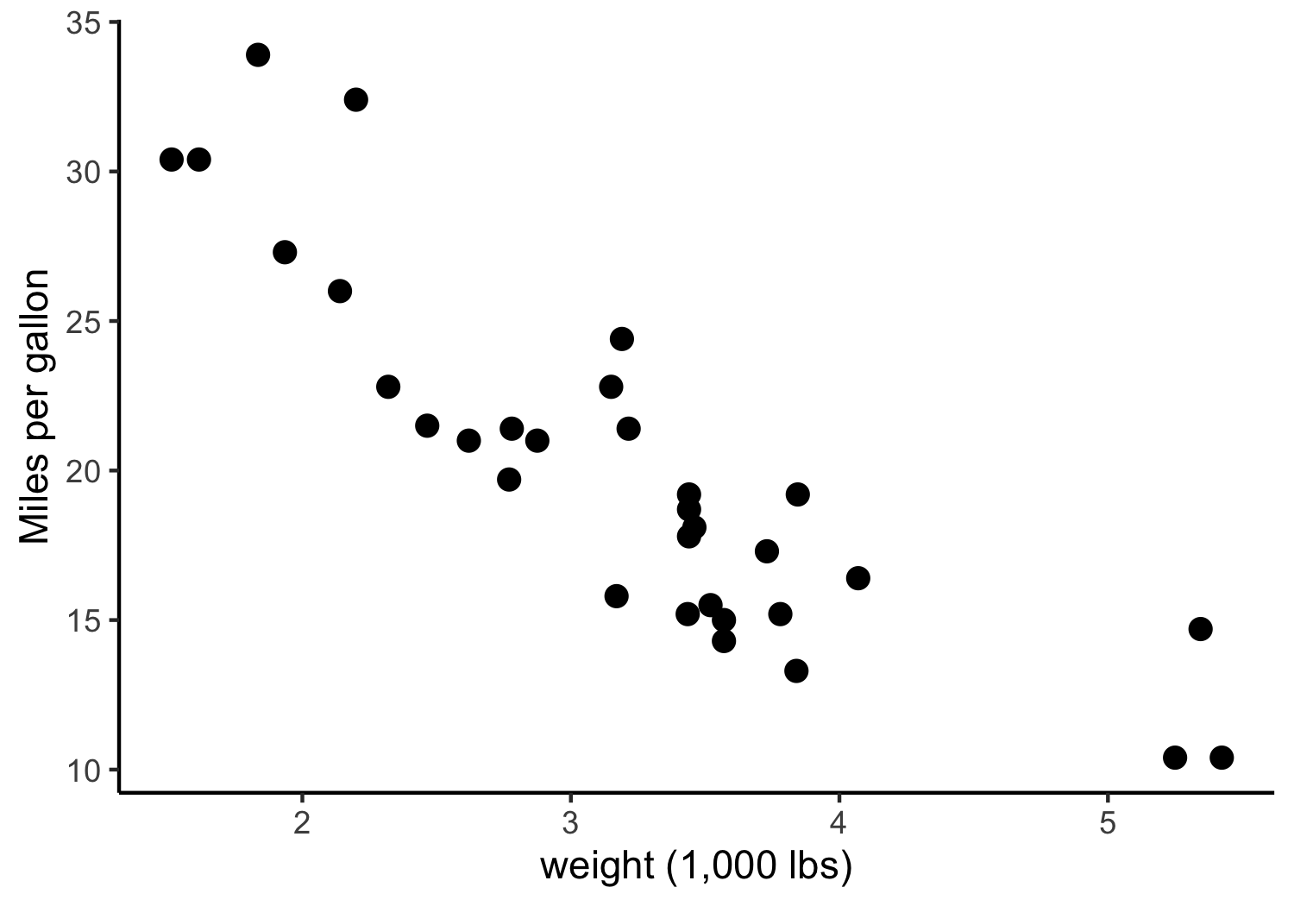
Notes:
You might think that detection is trivial but actually, for people not used to seeing a variety of data viz, this could be a challenge.
Here each point represents one car

Slide 57
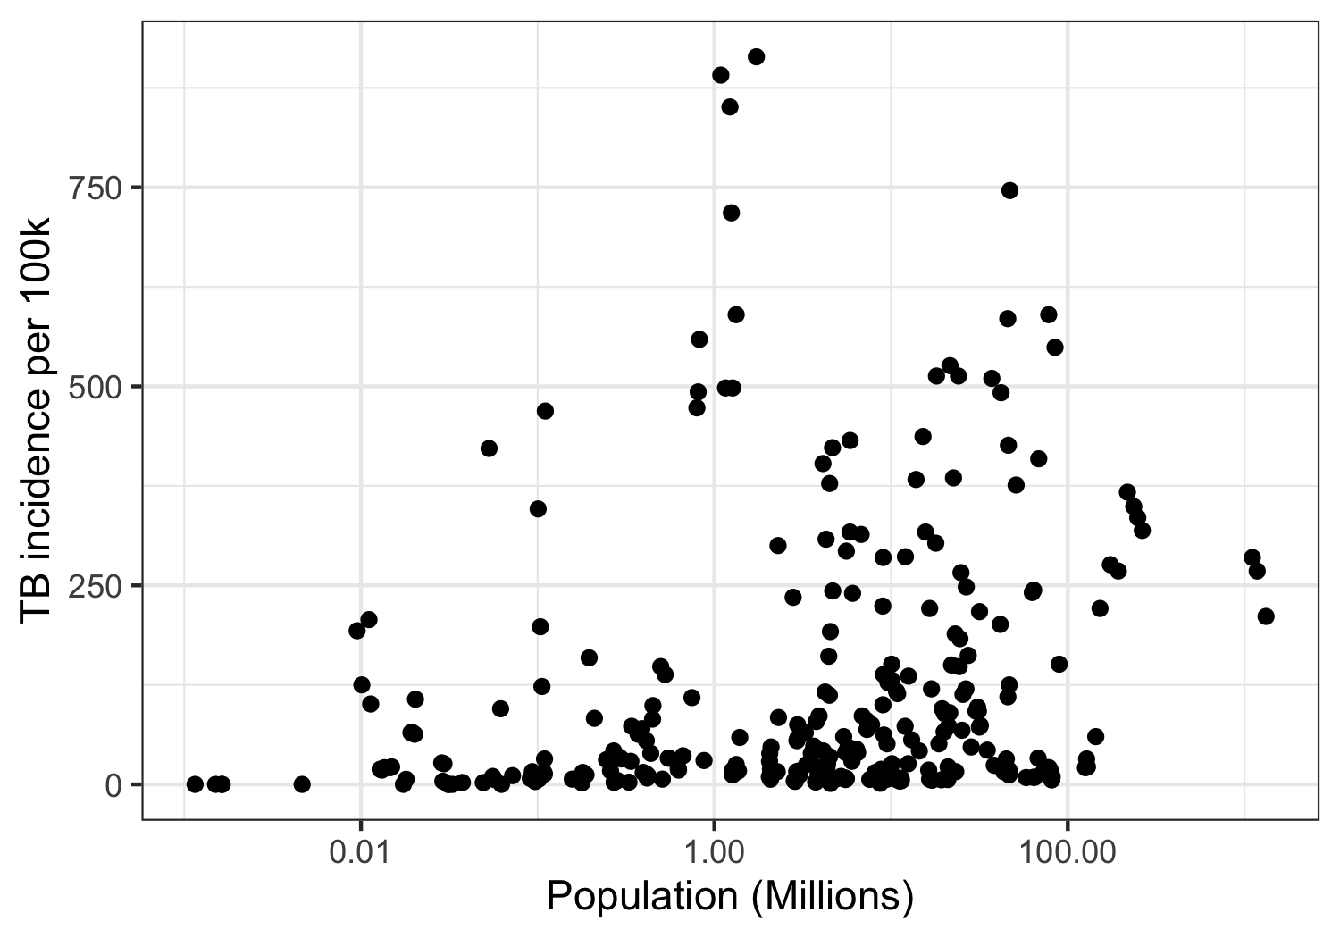
Notes:
Here each point represents a country in a given year

Slide 58
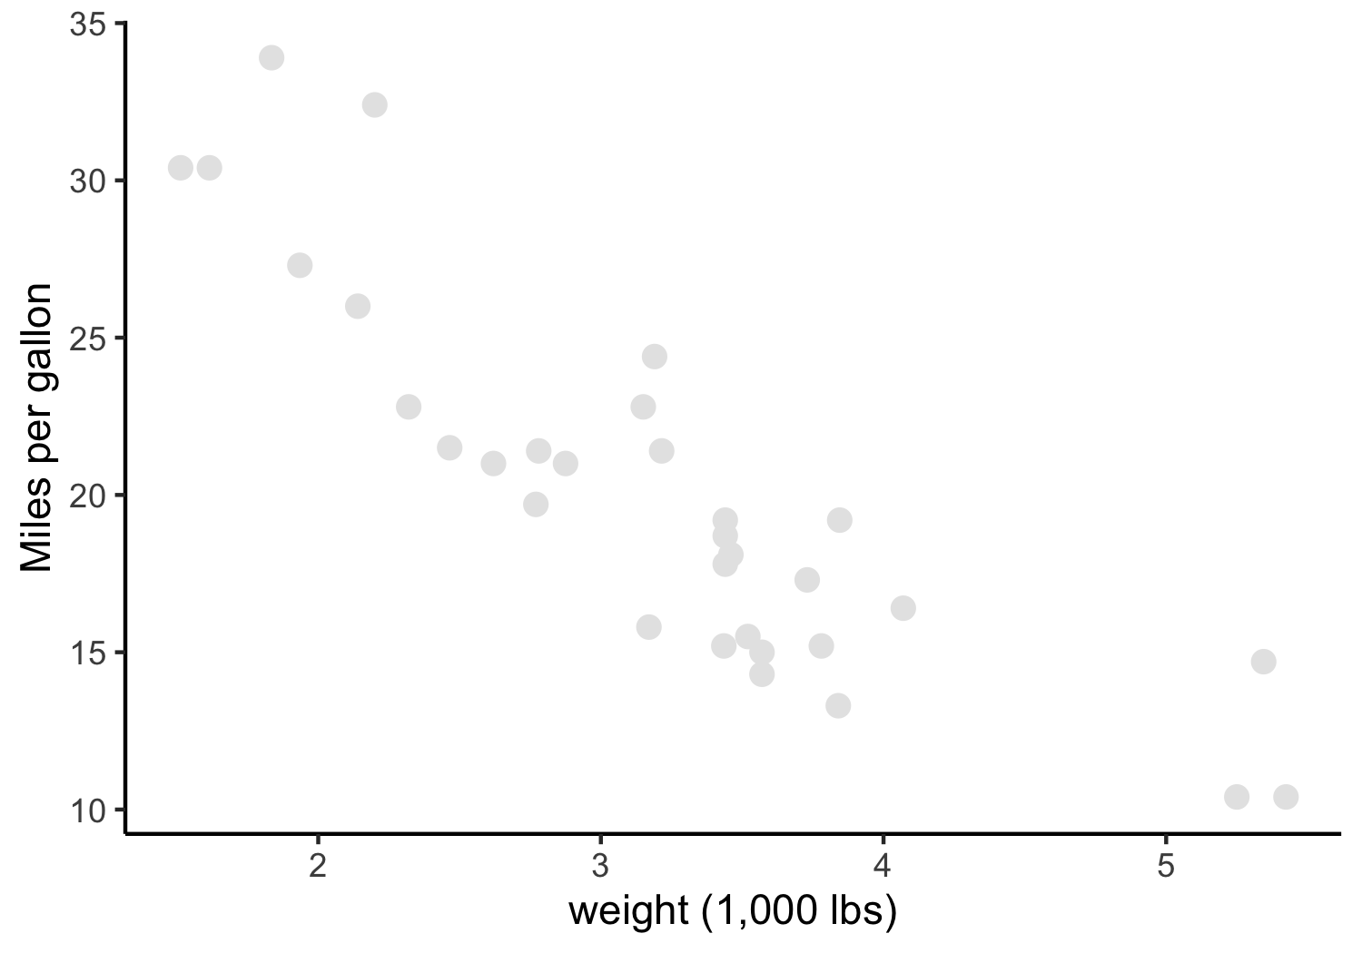
Notes:
By giving too little visual weight to the points, too little contrast in luminance between the points and the background, we make detection more difficult in this viz

Slide 59

Notes:
Here the points are too small

Slide 60
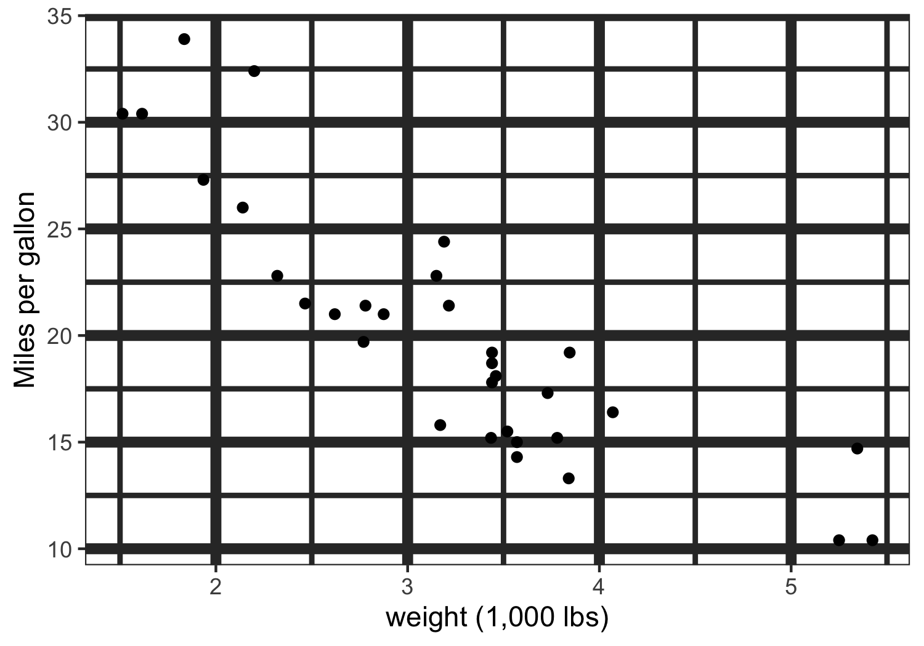
Notes:
Introducing other elements that compete with the points for detection

Slide 61
Notes:
Excel’s defaults are pretty bad, specifically you should change the saturation of the gridlines so that they fade into the background and consider making the data line bolder

Slide 62
“Above all else, show the data”
- Tufte

Slide 63
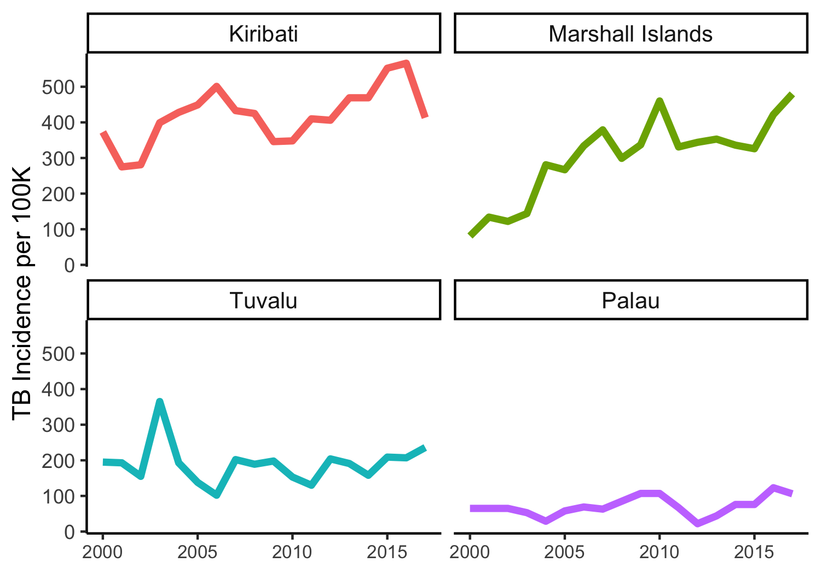
Notes:
Should we have gridlines at all?
How does the peak in Tuvalu’s TB incidence compare to the same time period in Kiribati – hard to tell without gridlines

Slide 64
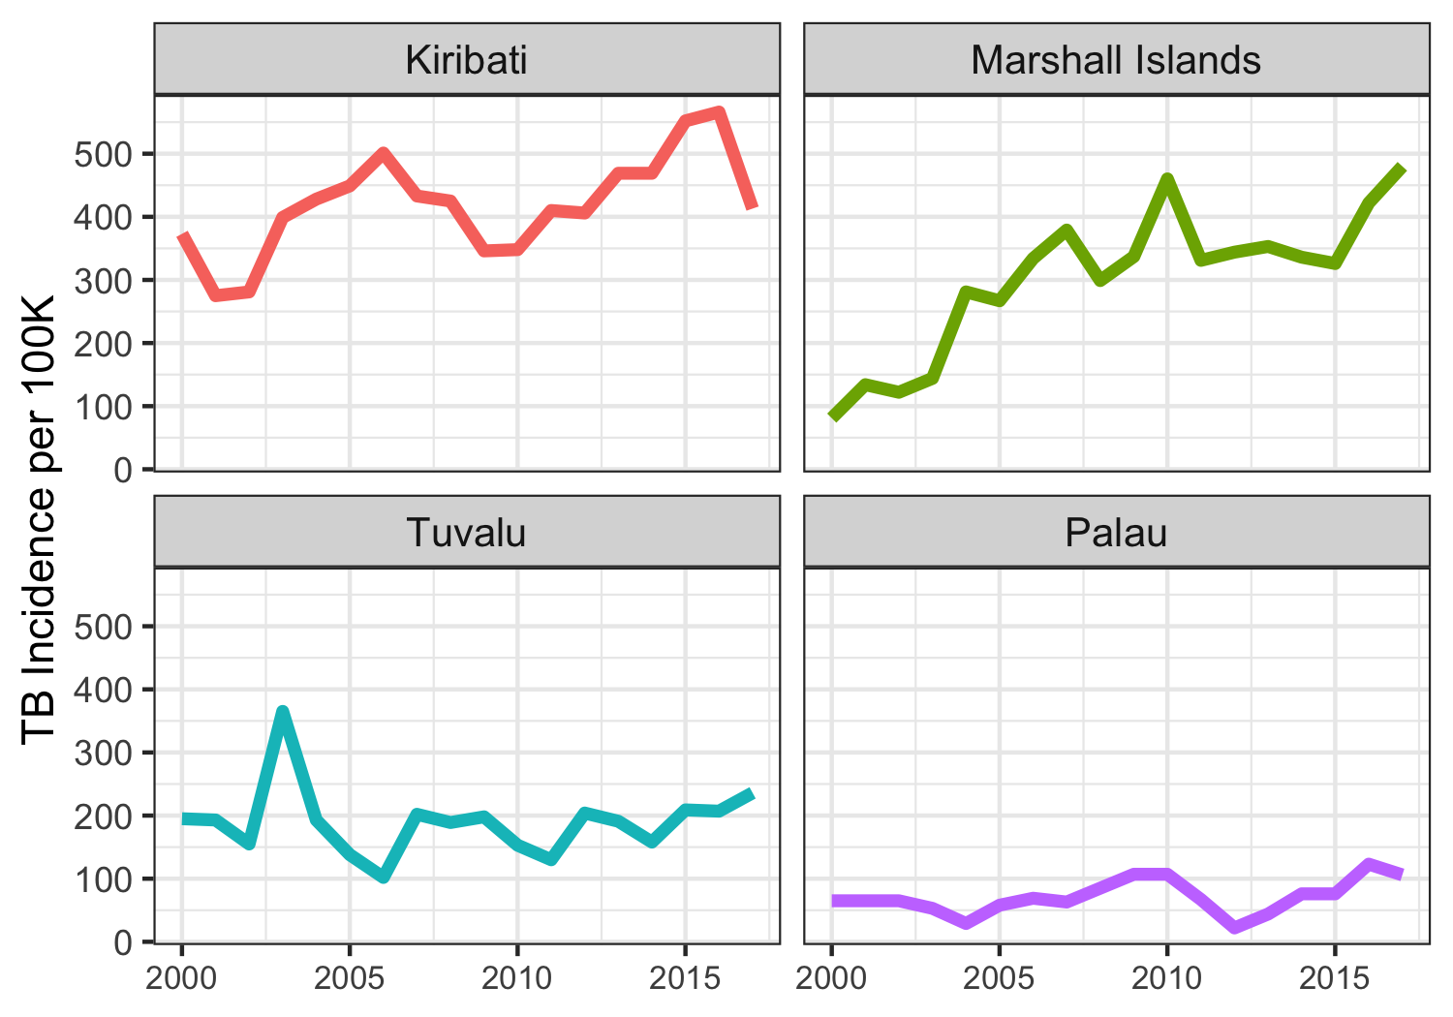
Notes:
Same plot but with gridlines. With the simple addition of gridlines we are able to see that in 2003 Tuvalu’s TB incidence peak is above 350 while in Kiribati in 2003 it is up at 400. Because we are looking within a smaller box, we are more easily able to detect small differences

Slide 65
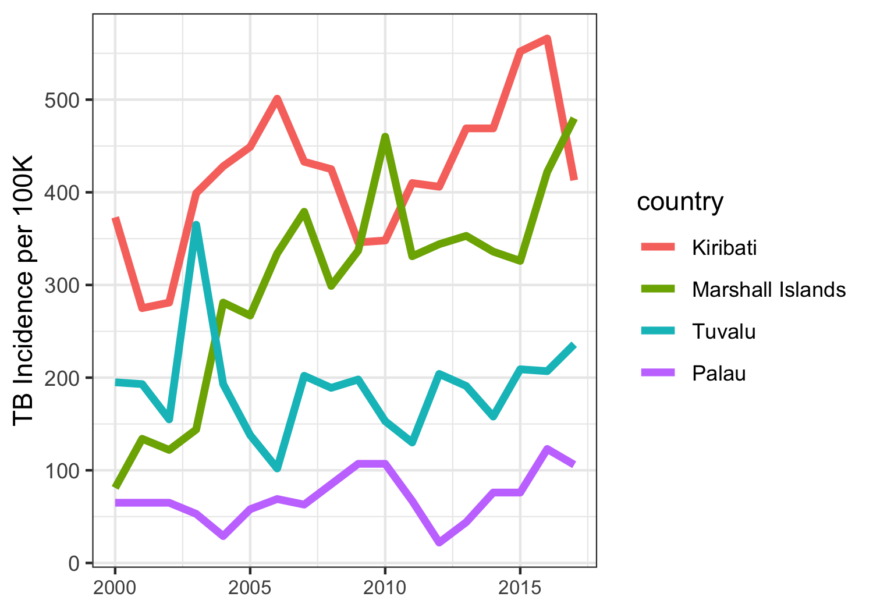
Notes:
Even better would be all 4 countries on the same plot so we don’t have to do 2 separate lookups

Slide 66
“Erase non-data ink,
within reason”
- Tufte

Slide 67
Should we include 0 on the axis?

Slide 68
Notes:
Yes, include 0 since we are relying on preattentive processing of color saturation to tell us the incidence of TB relative to 0

Slide 69
Notes:
Again, zero should be included since the size of the area of the dot corresponds directly to the TB incidence relative to 0. 0 TB would have 0 area

Slide 70
Notes:
What about in a plot like this where the encoding is position on a common scale. Is including zero on the scale important? For the tuberculosis dataset, we did include 0 but only because it was close to the minimum tb value

Slide 71
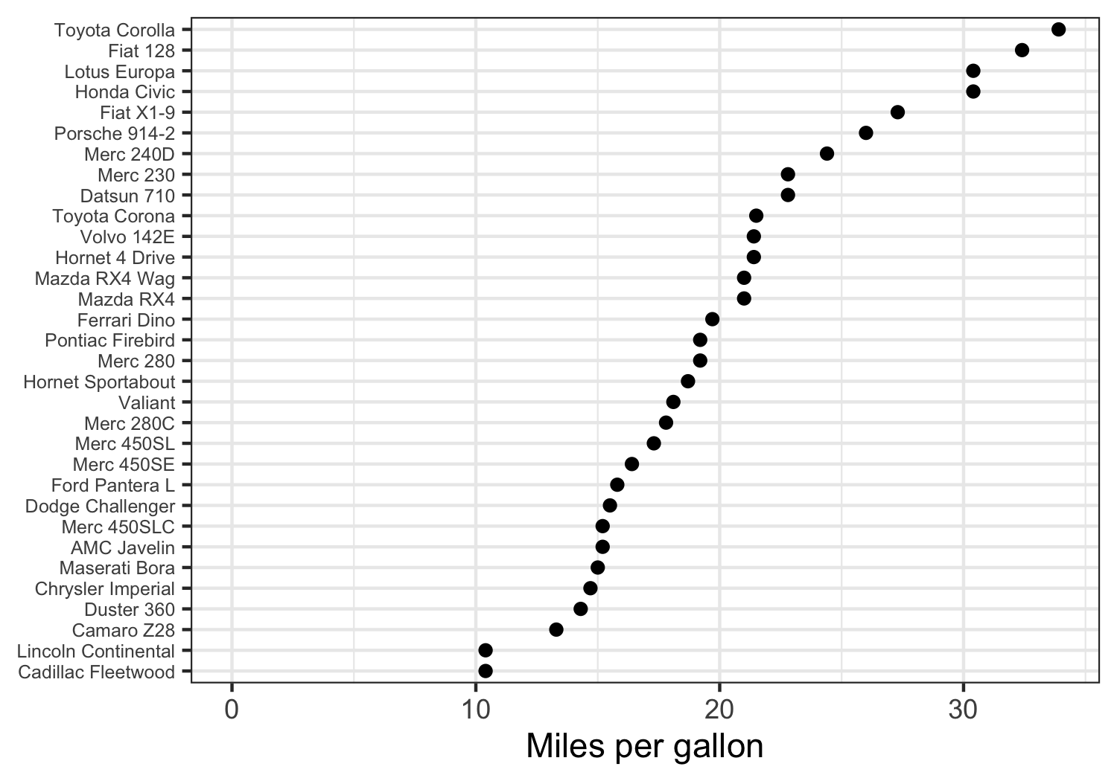
Notes:
In this dataset, the minimum miles per gallon any model of car gets is above 10. Because we are comparing the positions with each other rather than the length of the bars, including zero here is not necessary and just wastes space.

Slide 72
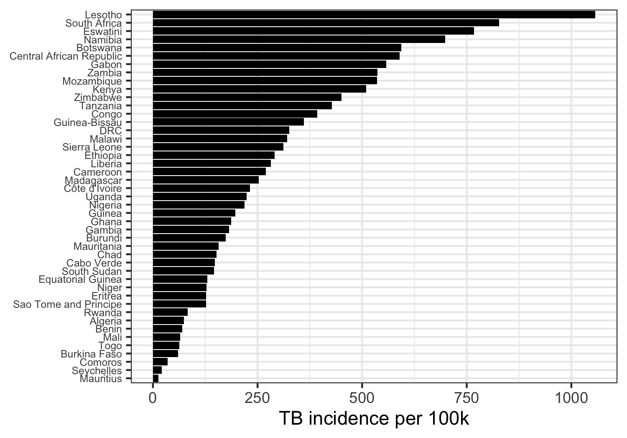
Notes:
Bar chart – people say that readers are comparing position of the ends of the bar but if you draw the bar, I say you are encouraging people to detect and compare the lengths of the bar. Therefore, they should start at zero

Slide 73
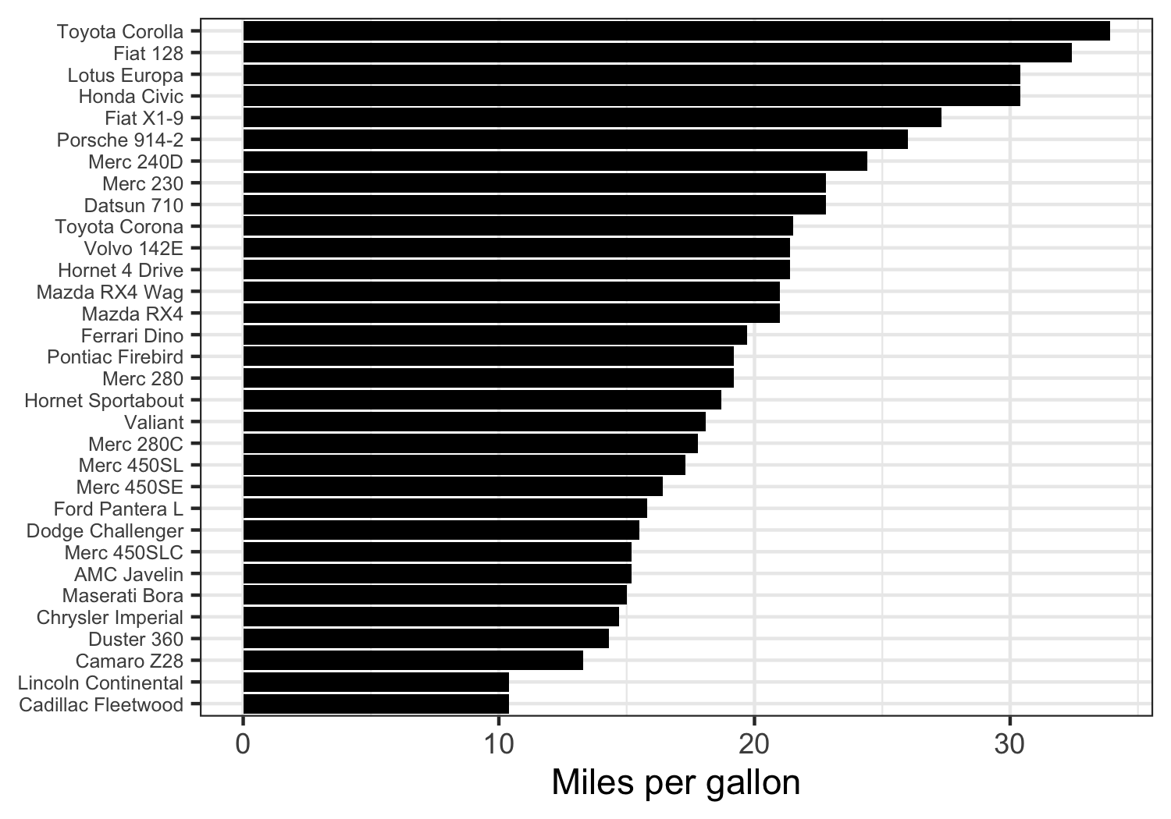
Notes:
Bar chart – people say that readers are comparing position of the ends of the bar but if you draw the bar, I say you are encouraging people to detect and compare the lengths of the bar. Therefore, they should start at zero

Slide 74
Should we include 0 on the axis?
If encoding relies on pre-attentive processing of size or intensity, you must include 0 to not mislead
If encoding relies on position, you decide

Slide 75
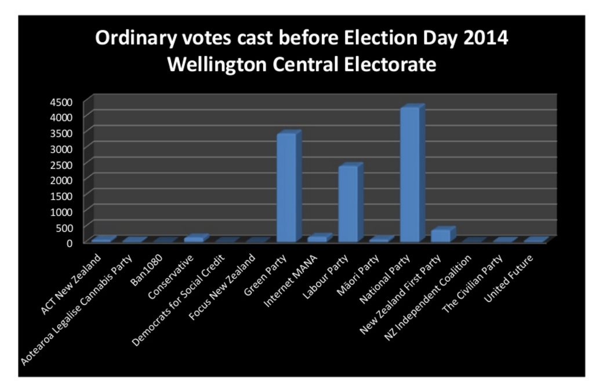
Improve this plot

Slide 76
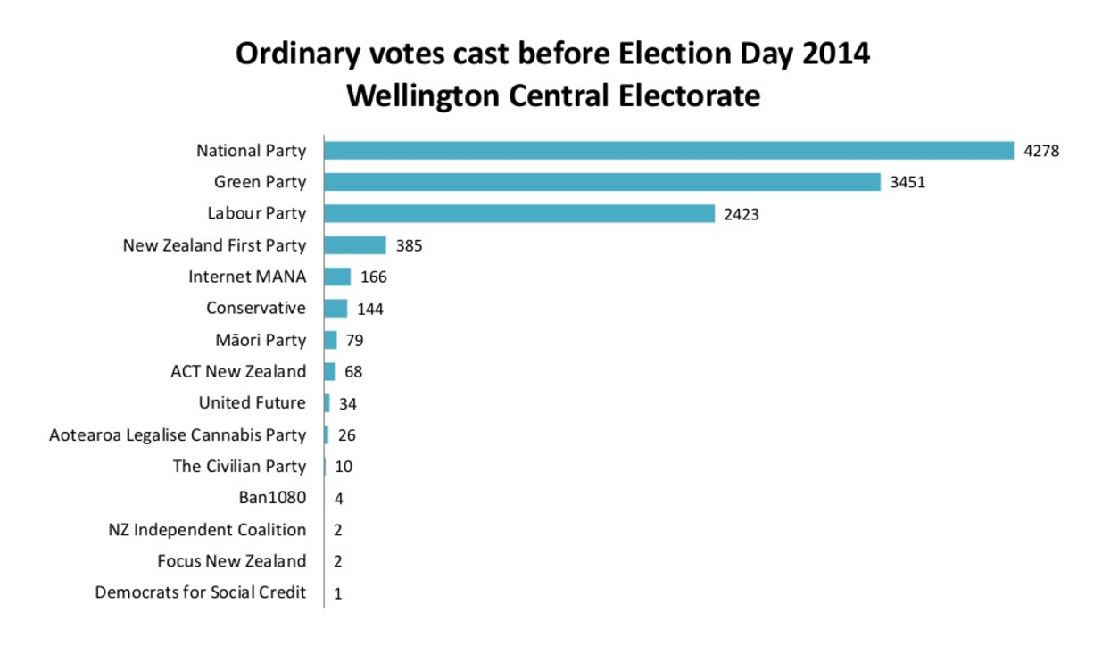

Slide 77
Code for these plots available

Slide 78
If you want help creating your next, best data viz
data.hsl.virginia.edu
Marieke@virginia.edu

Slide 79
Credits and Further Resources
John Rauser – How humans see data (talk) https://www.youtube.com/watch?v=fSgEeI2Xpdc&feature=youtu.be
Karl Broman (talk) https://github.com/kbroman/Talk_Graphs
Claus Wilke – Fundamentals of Data Visualization (ebook) https://serialmentor.com/dataviz/
Claus Wilke – Giving Effective Presentations (talk) https://www.slideshare.net/ClausWilke/giving-effective-presentations-oct-2016

